Slide 1
Reactive Architectures
Succeeding with Reactive Architectures
Ian Cooper
ICooper@Twitter
@Icooper@hachyderm.io
@icooper.bsky.social

Slide 2
Who are you?
Software Developer for more than 25 years
Stuff I care about: Messaging, EDA, Microservices, TDD, XP, OO, RDD & DDD, Code that Fits in My Head, C#
Places I have worked: DTI, Reuters, Sungard, Beazley, Huddle, Just Eat Takeaway
No smart folks
Just the folks in this room

Slide 3
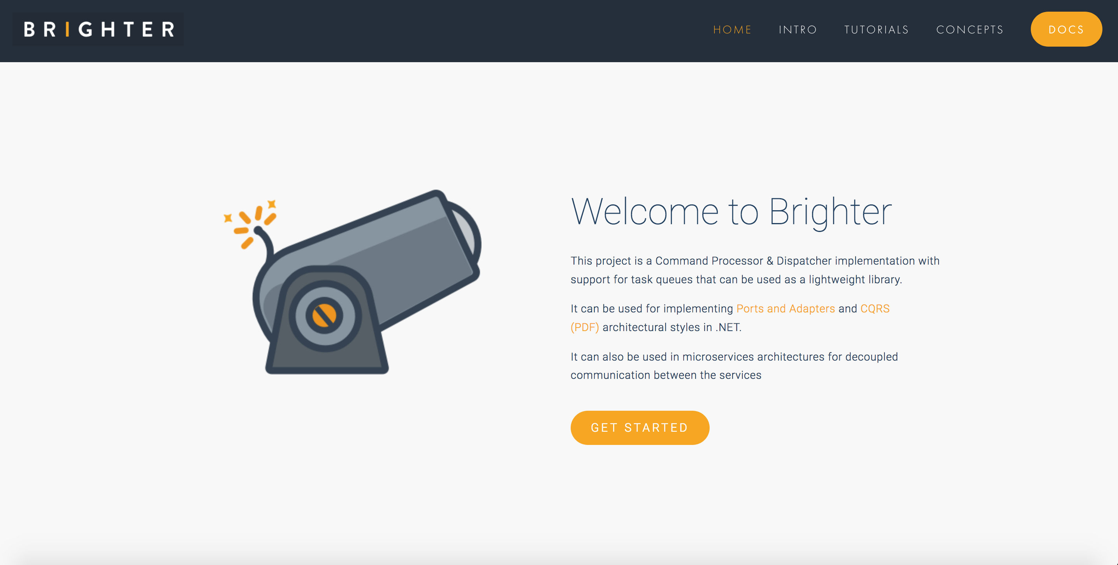

Slide 4
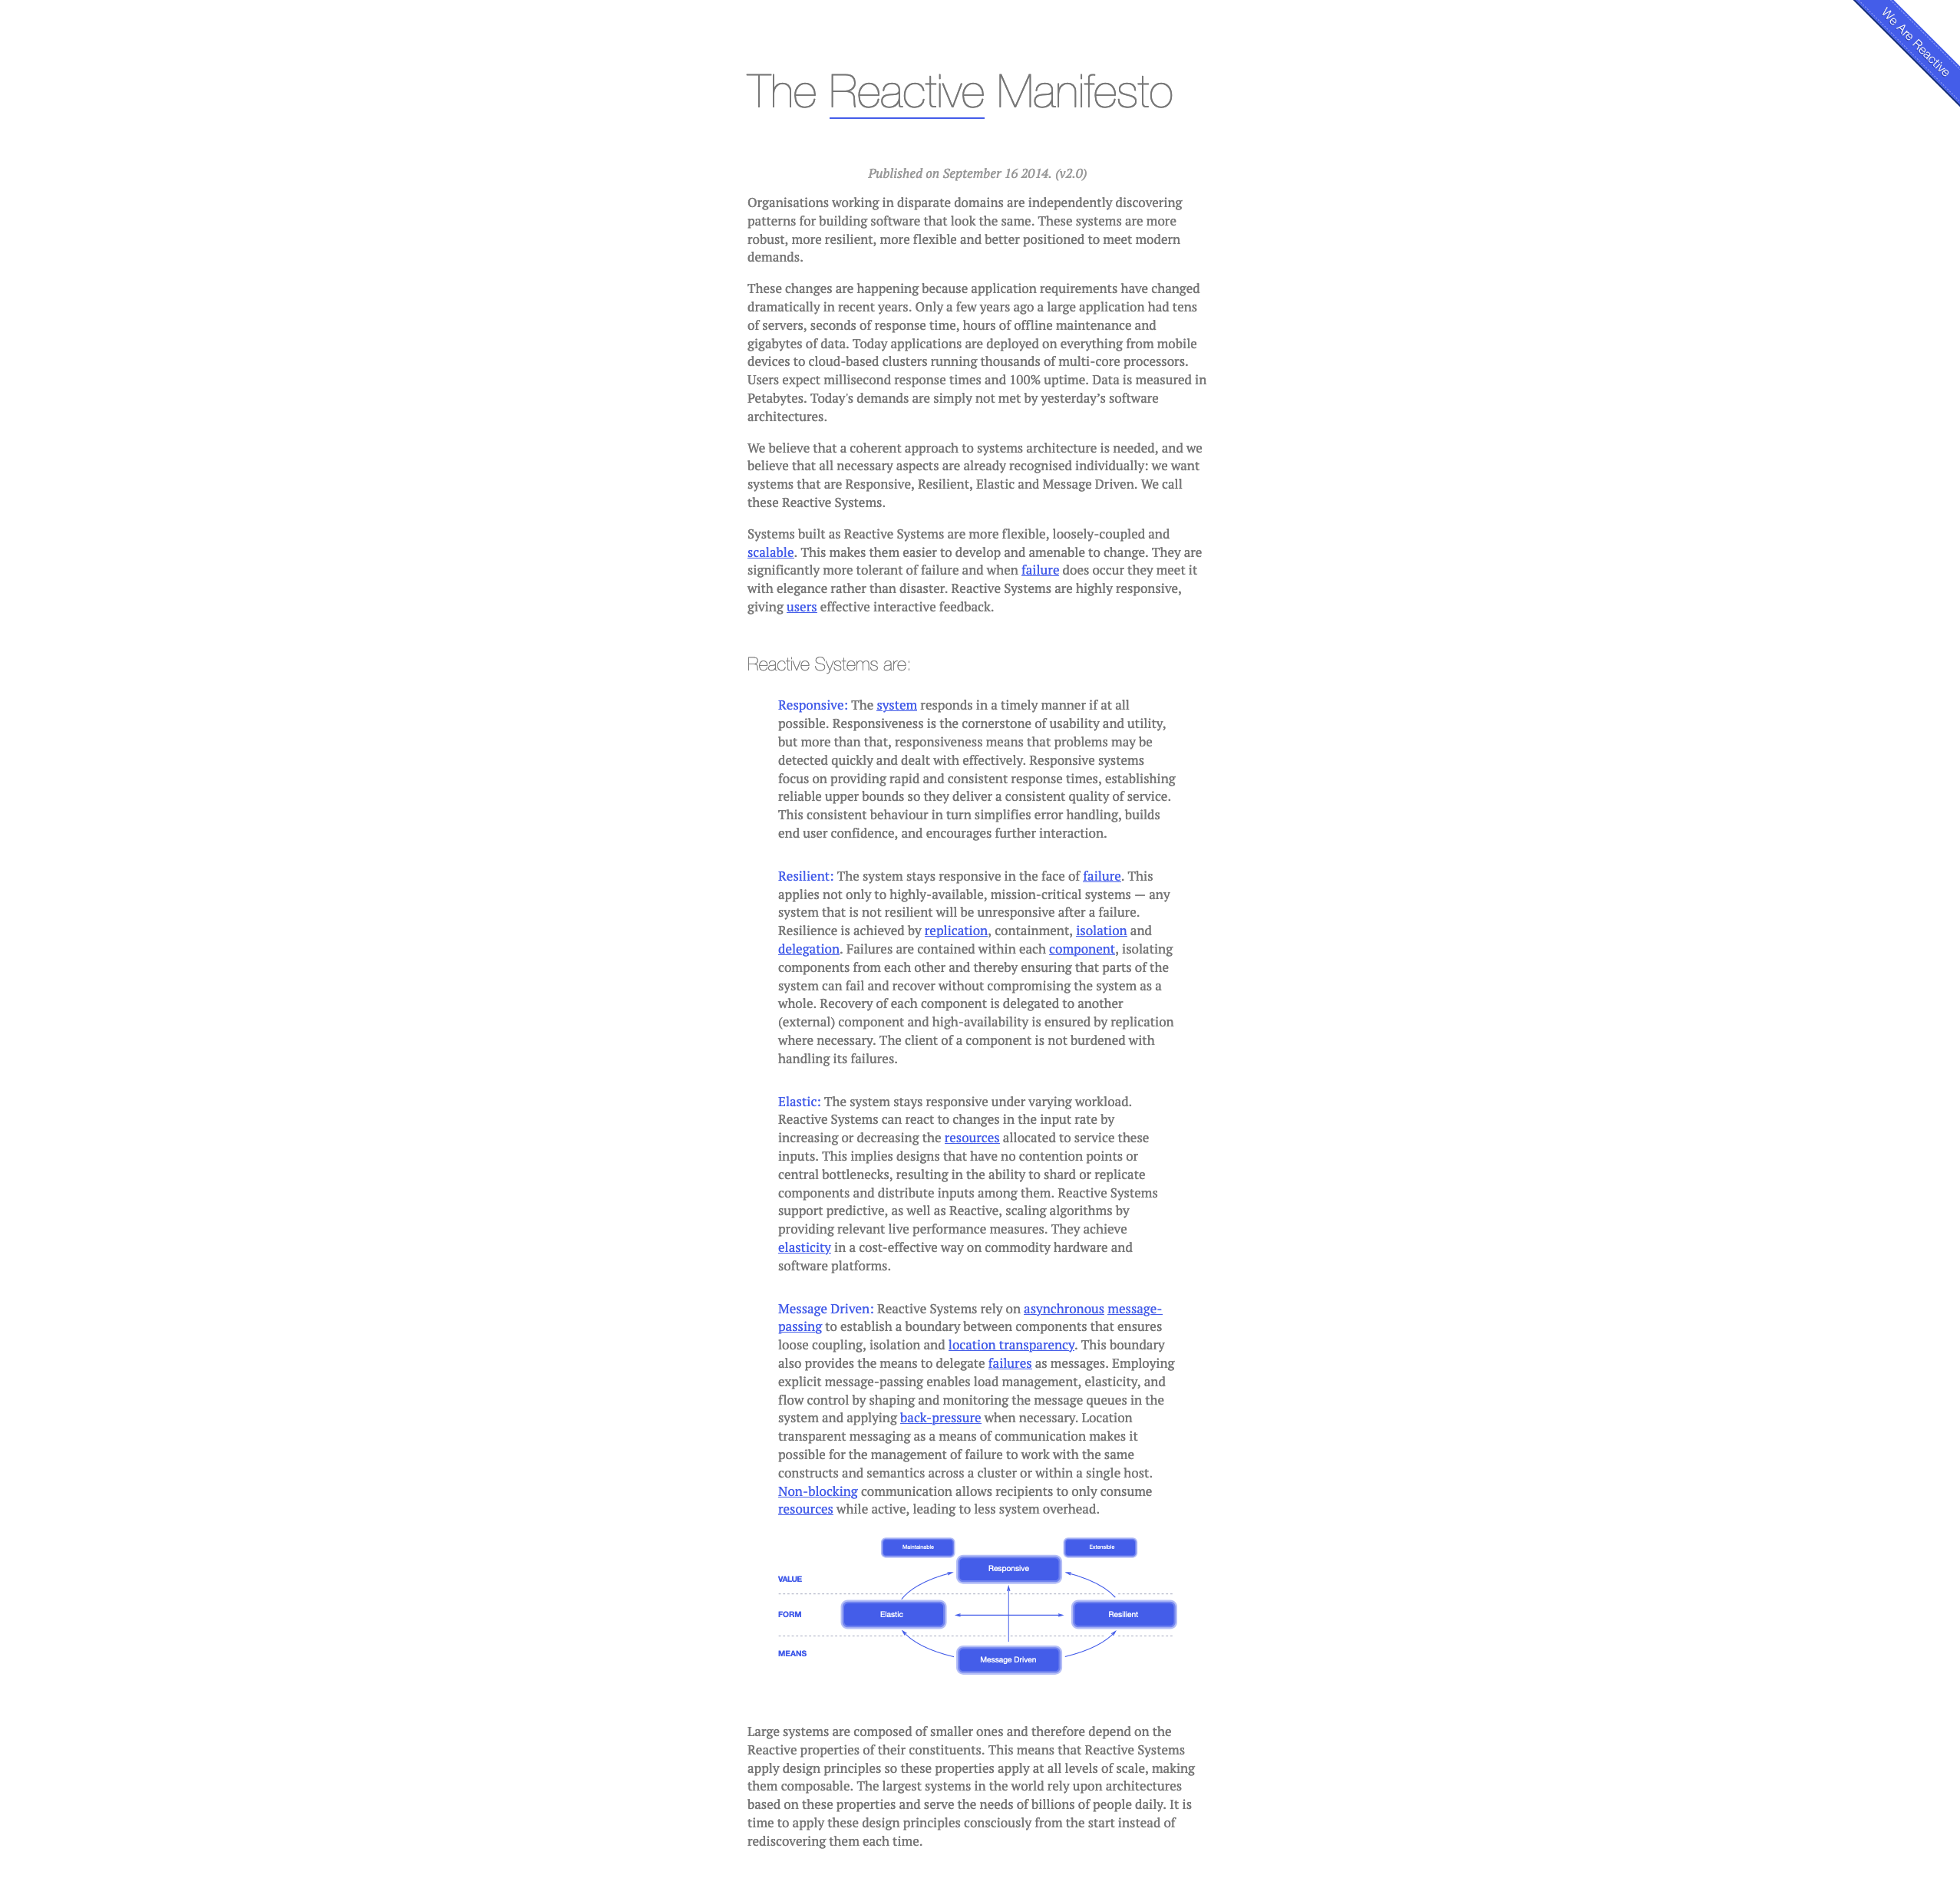
The Reactive Manifesto
Published in September 2014
Author(s): Jonas Bonér (Erik Meijer, Martin Odersky, Greg Young, Martin Thompson, Roland Kuhn, James Ward and Guillaume Bort)
Defines an architectural style: Reactive Applications
Write applications that:
react to events: the event-driven nature enables the following qualities
react to load: focus on scalability rather than single-user performance
react to failure: resilient systems with the ability to recover at all levels
react to users: combine the above for an interactive user experience
Responsive: The system responds in a timely manner.
Resilient: The system stays responsive in the presence of failure.
Elastic: The system stays responsive under varying workload.
Message Driven: Rely on asynchronous message passing
https://www.reactivemanifesto.org/
Notes:
Not just the actor model!!! These ideas have seen expression beyond the actor model, and we would rather follow Helland in noting that many implementations are possible, including the actor model and we will talk about a few of them

Slide 5
Value
Responsive
Form
Elastic
Resilient
Means
Message Driven

Slide 6
This talk is not about specific implementations such as the actor model, but about how we use the insights of ‘reactive programming’ as a paradigm for how we design larger systems

Slide 7
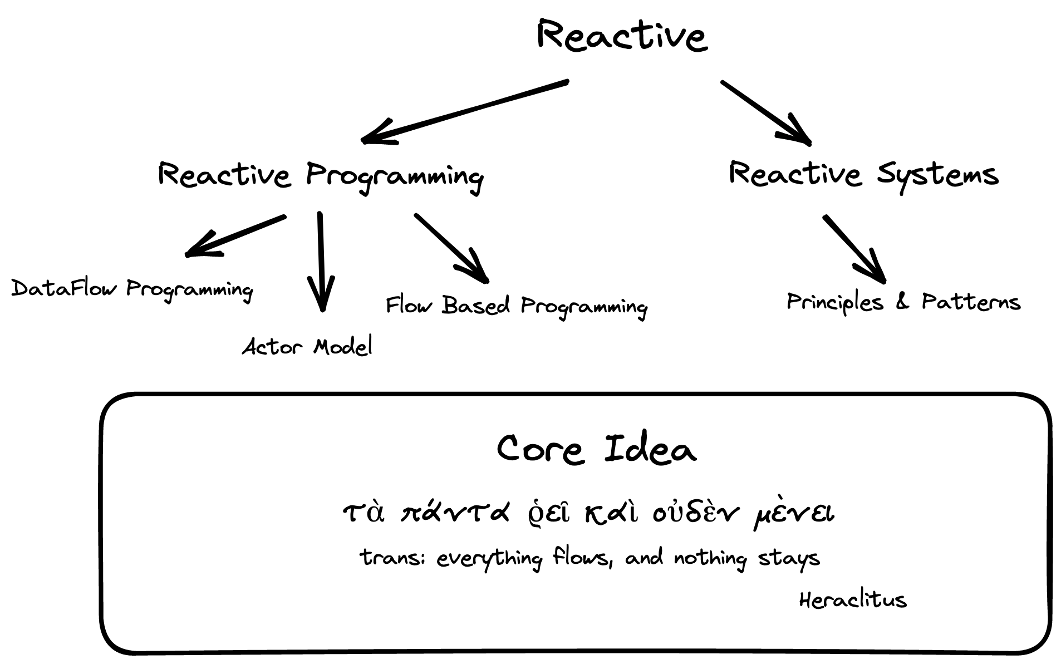
Notes:
Core idea: we model software as a flow of data, a stream, and our requirements as transformations to that data

Slide 8
Agenda
Objects
SOA
Reactive
Reactive Programming
Dataflow
Actors
Flow Based Programming
Reactive Systems
Message Passing
Resilience
Elasticity
Responsiveness

Slide 9
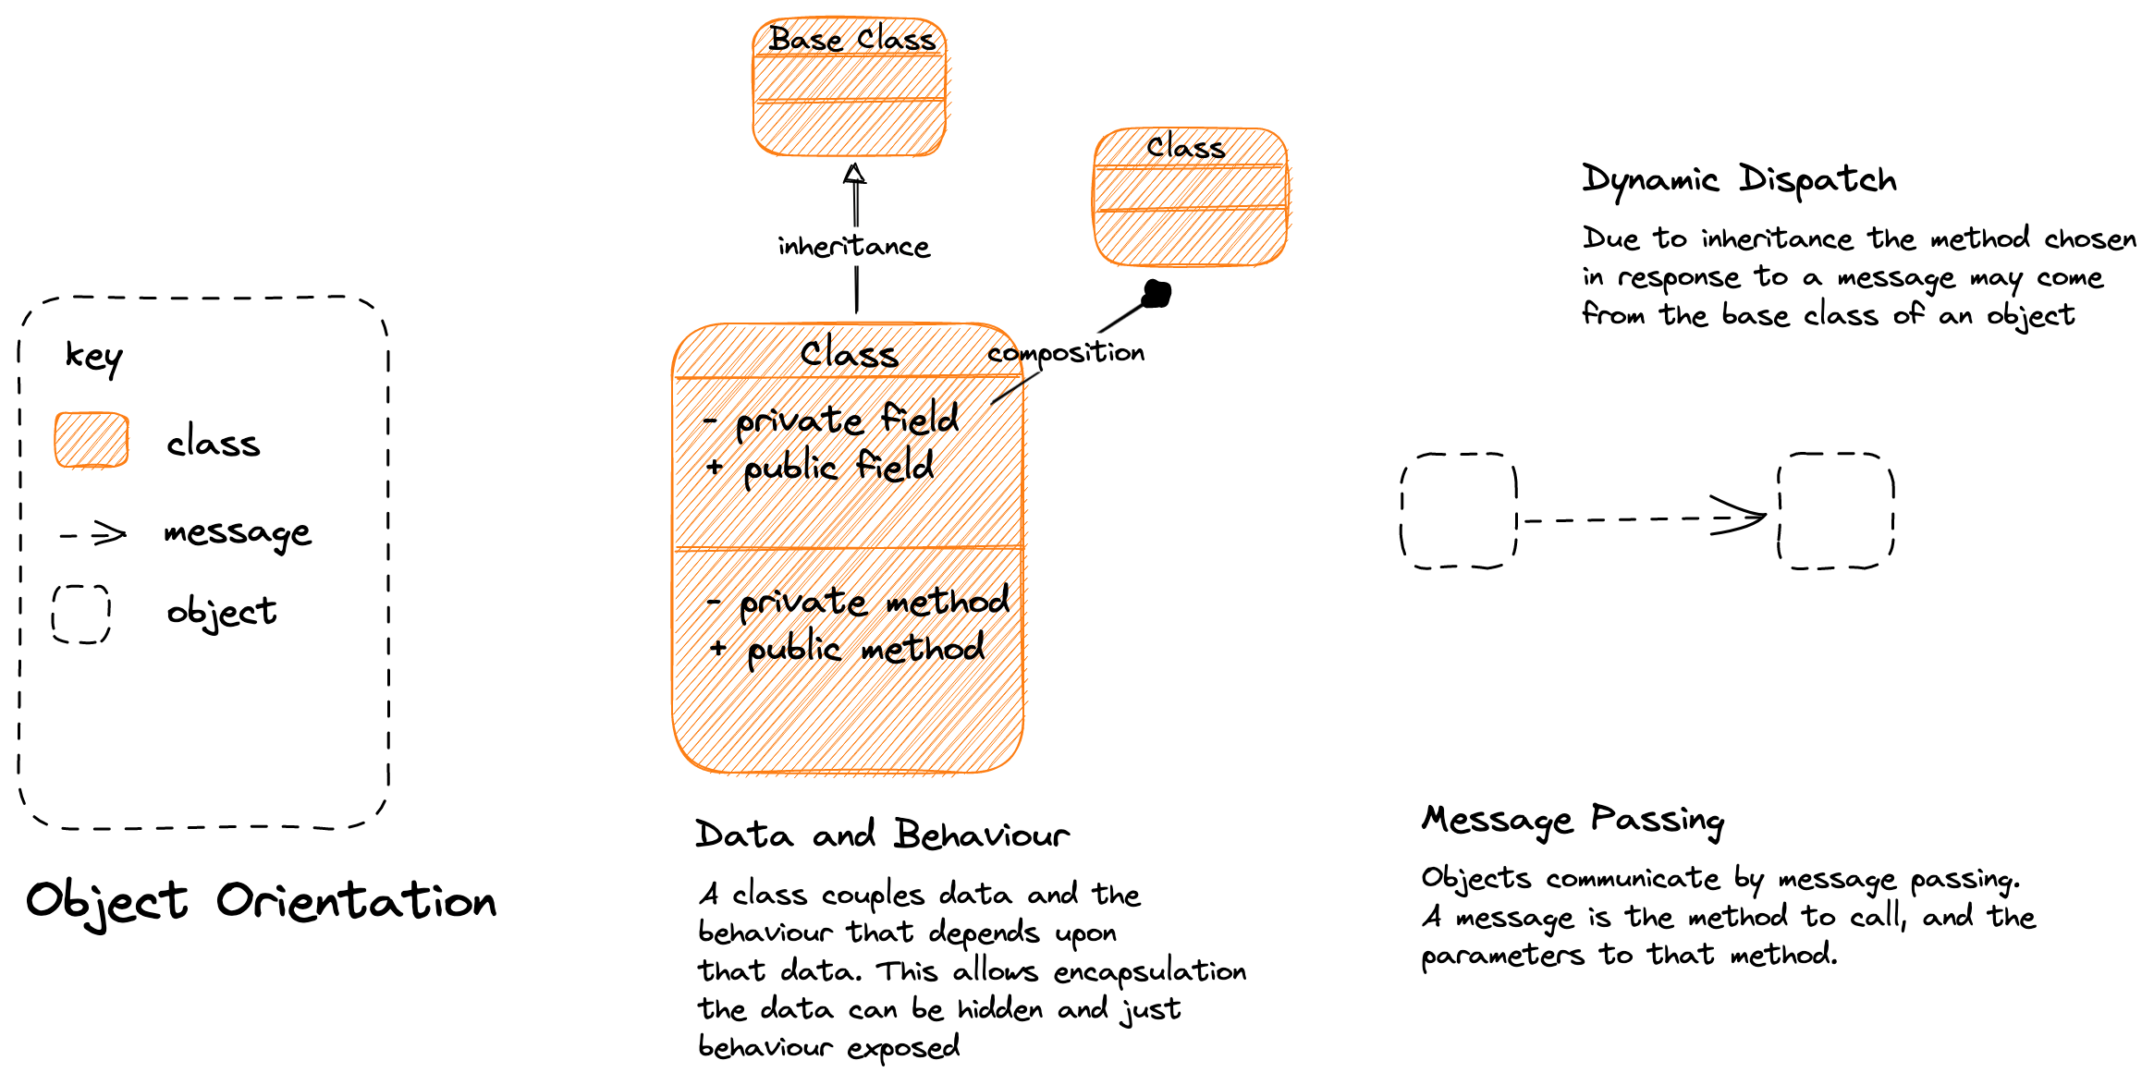
Notes:
A class has a role, with attendant responsibilities
We capture those responsibilities as behaviors
We encapsulate the data that those behaviors need within the object
A system passes control to meet a use case between different classes with roles in the system, via message passing
This is a “call and return” approach i.e. main on down
Roles may be inherited via dynamic dispatch.

Slide 10
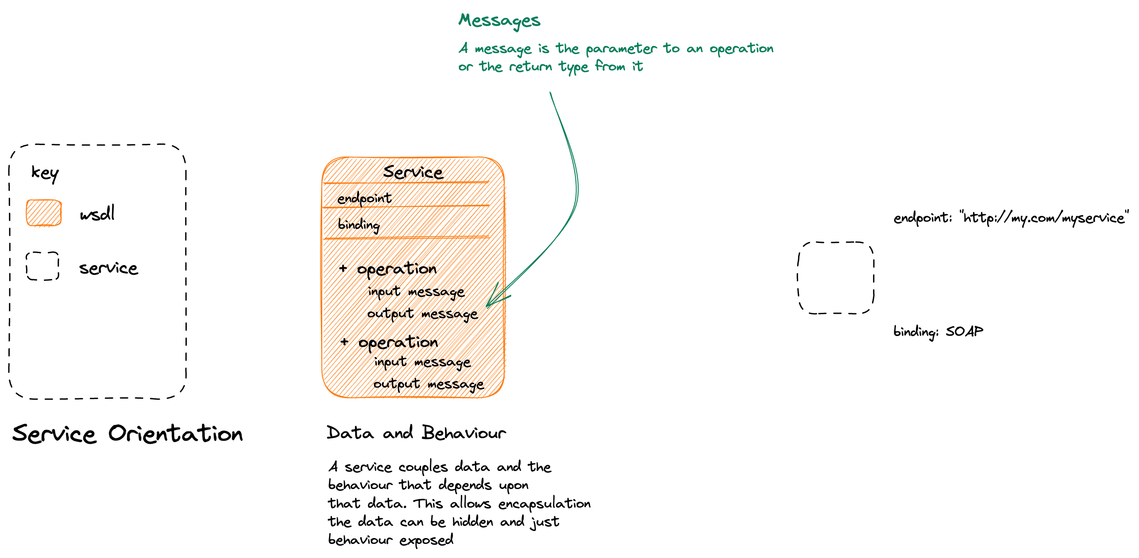
SOA & OO: SOA creates OO-like components, they encapsulate their data and expose behavior that is coupled to that data. This is the Web Services approach to services.
Notes:
A service has a role in the system, and attendant responsibilities which it exposes via various operations/behaviors.
The service encapsulates the data that it is associated with thos behaviors
This is OO as an architectural principle.

Slide 11
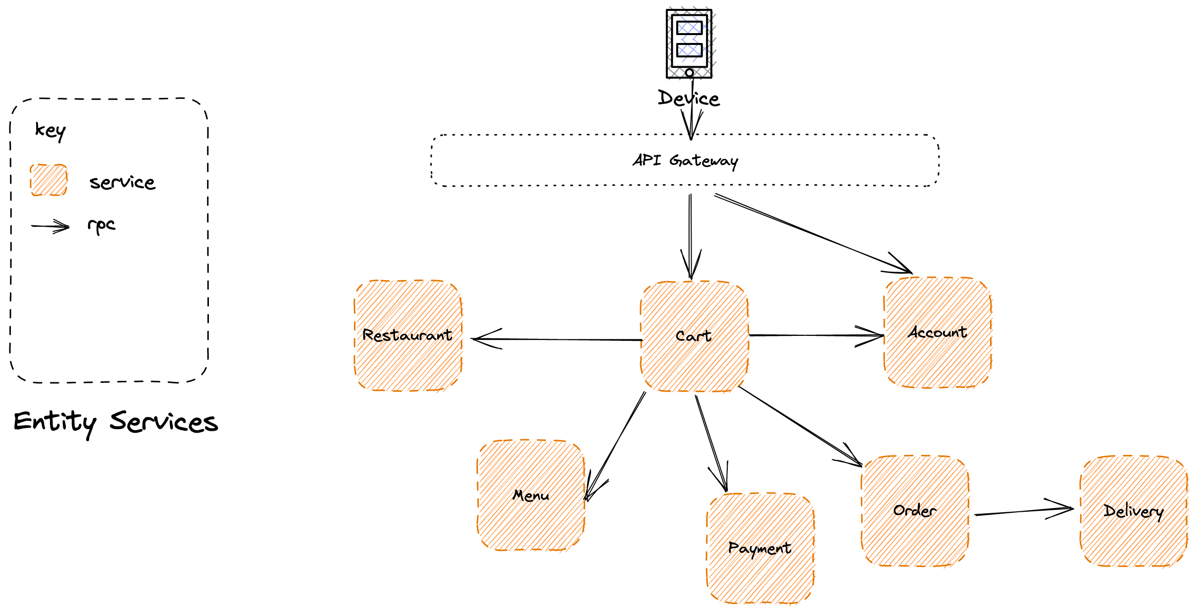
Feature Envy: Because domain logic needs to co-ordinate across these resources, it ends up either on the client, the API Gateway, or the Cart service and not in individual services. An anti-pattern.
SOA & OO: We expose significant resources and operations that you can perform upon them, often CRUD.
Notes:
Because we are making OO large, we have a tendency to use ”call and return” via a main method at our API gateway.
The problem with this is that we are effectively creating a distributed monolith because we are driving from our main method – the gateway.
Is there a better paradigm??

Slide 12
RPC is a synchronous conversation – both parties need to be active during the call
Faults Propagate: With a synchronous service, a fault propagates
Notes:
Typically we use RPC to replace the method calls, which tends to make us brittle as failure propogates

Slide 13
Agenda
T: 10
Objects
SOA
Reactive
Reactive Programming
Dataflow
Actors
Flow Based Programming
Reactive Systems
Message Passing
Resilience
Elasticity
Responsiveness

Slide 14
Agenda
T: 10
Objects
SOA
Reactive
Reactive Programming
Dataflow
Actors
Flow Based Programming
Reactive Systems
Message Passing
Resilience
Elasticity
Responsiveness

Slide 15
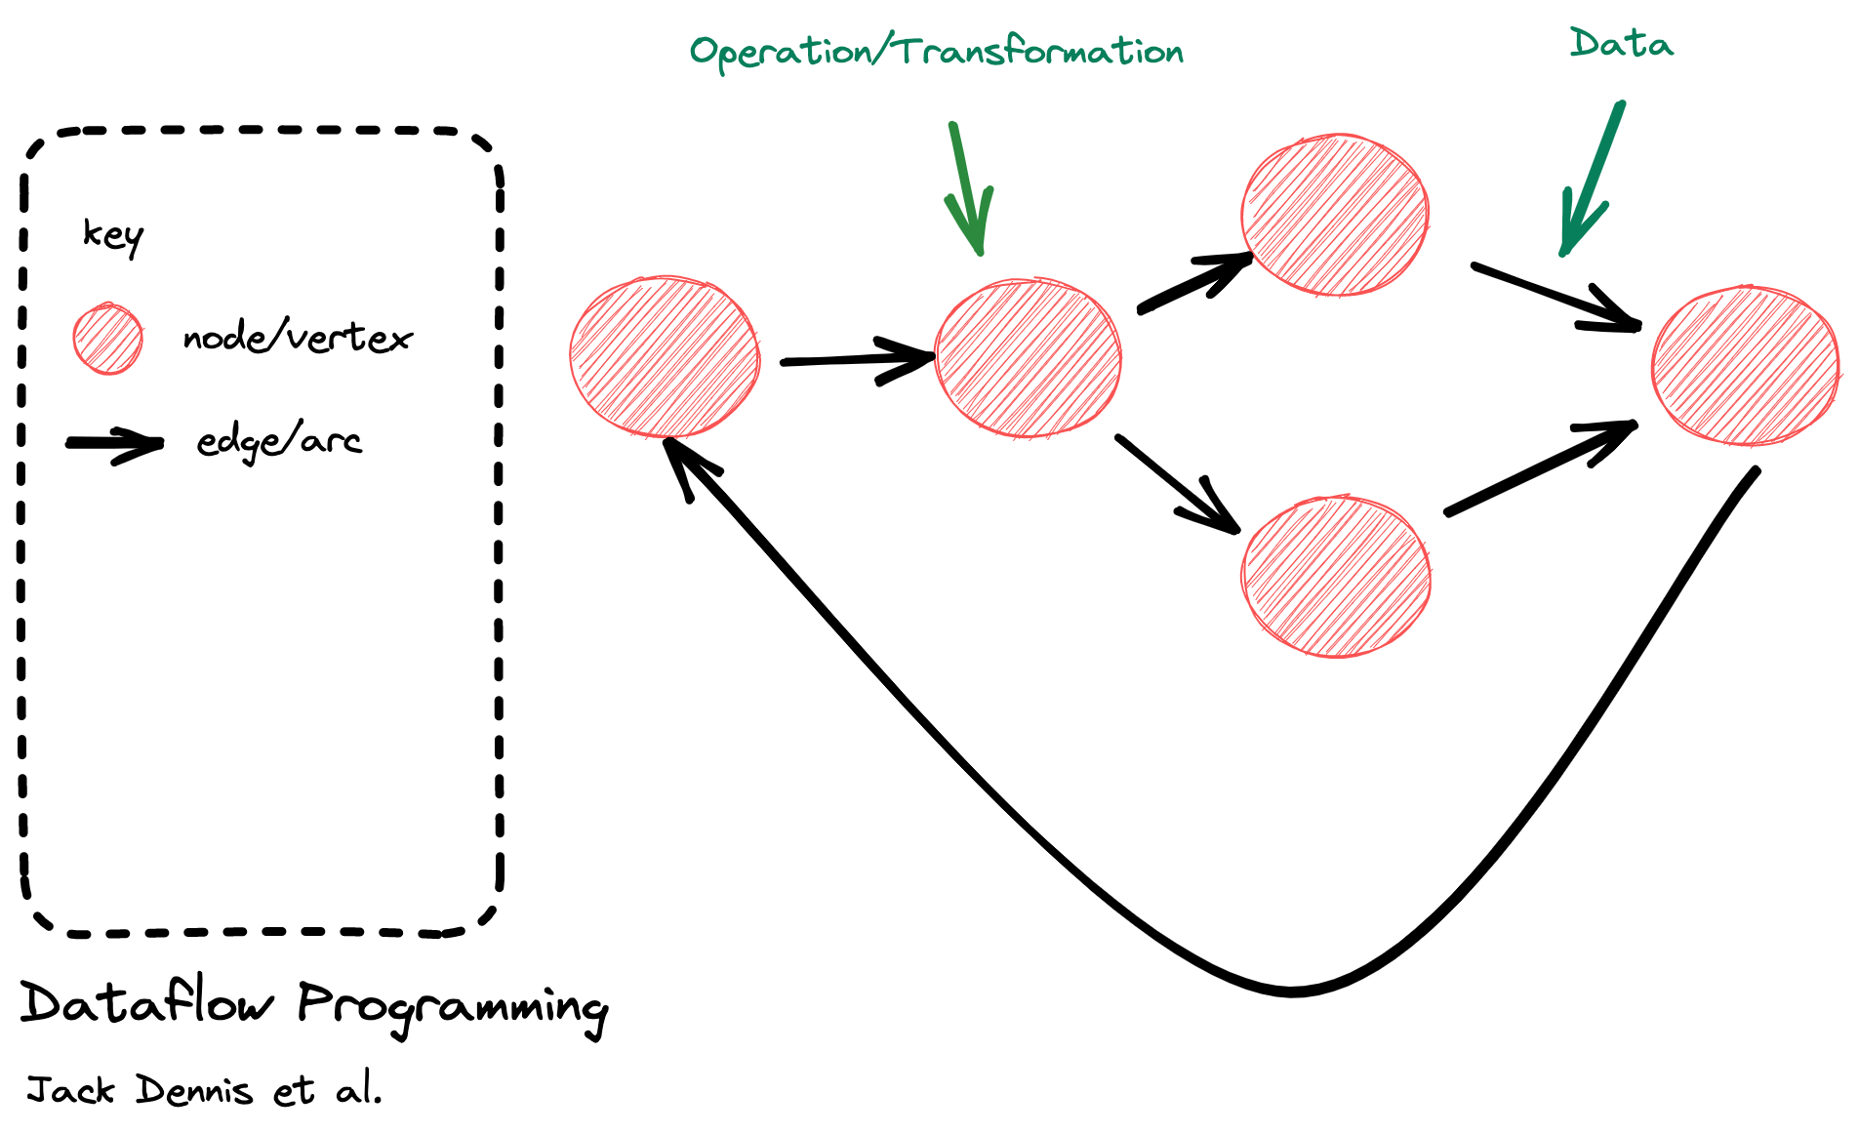
Data Flow Programming conceptualizes a program as a directed graph where operations are represented as nodes which are connected via arcs through which data flows. A node performs an operation when input data is available.
Notes:
Dataflow programming perhaps oldest expression of reactive approach.
Unlike OO where state is co-located in nodes with the behavior that acts upon that state, in dataflow programming data moves between transformations (nodes) via arcs (links).
Example: Unix CLI programming, pipes and filters etc.

Slide 16
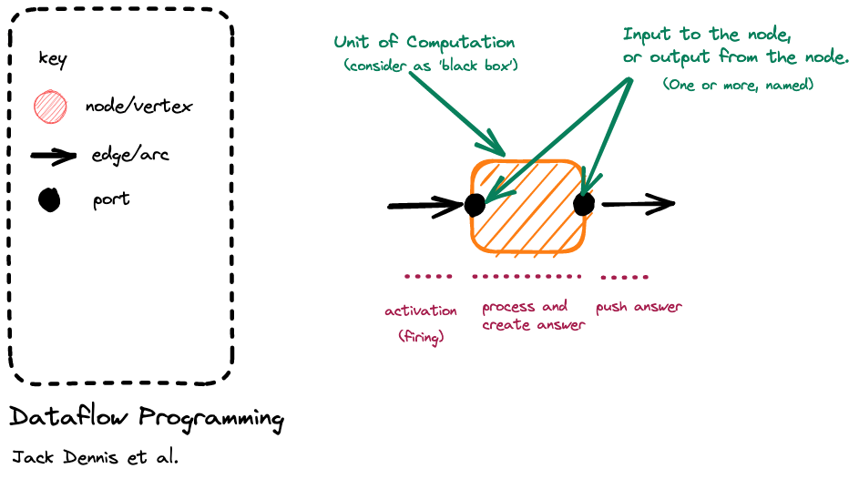
Notes:
Breaking it down, we have a node with an input port, it is activated or fired when an event arrives on the input port arc; it responds to that event with come computation; as it is a ’black box’ it signals what happened by raising an event on an output port (to which others may react)
It is reactive because it fires up in response to an event being raised
Generally a node is single threaded.

Slide 17
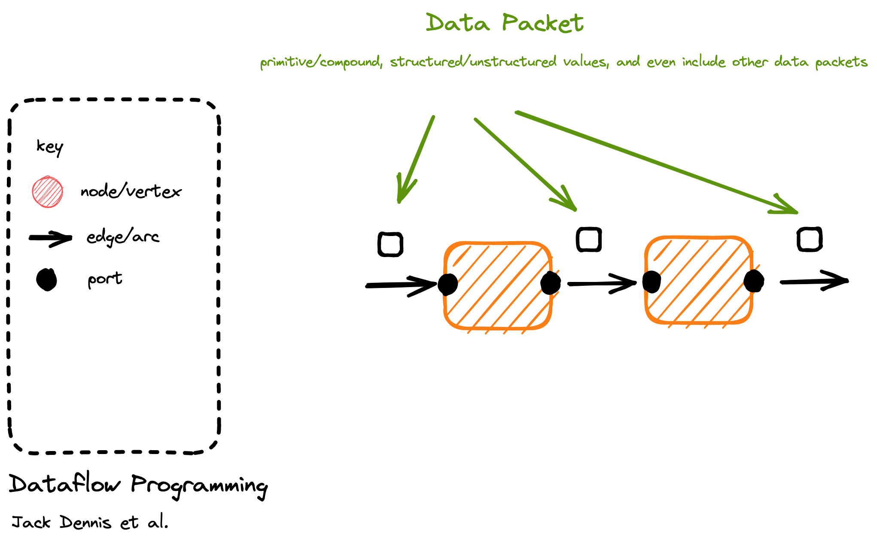
Notes:
No special requirements about packets, they are just data

Slide 18
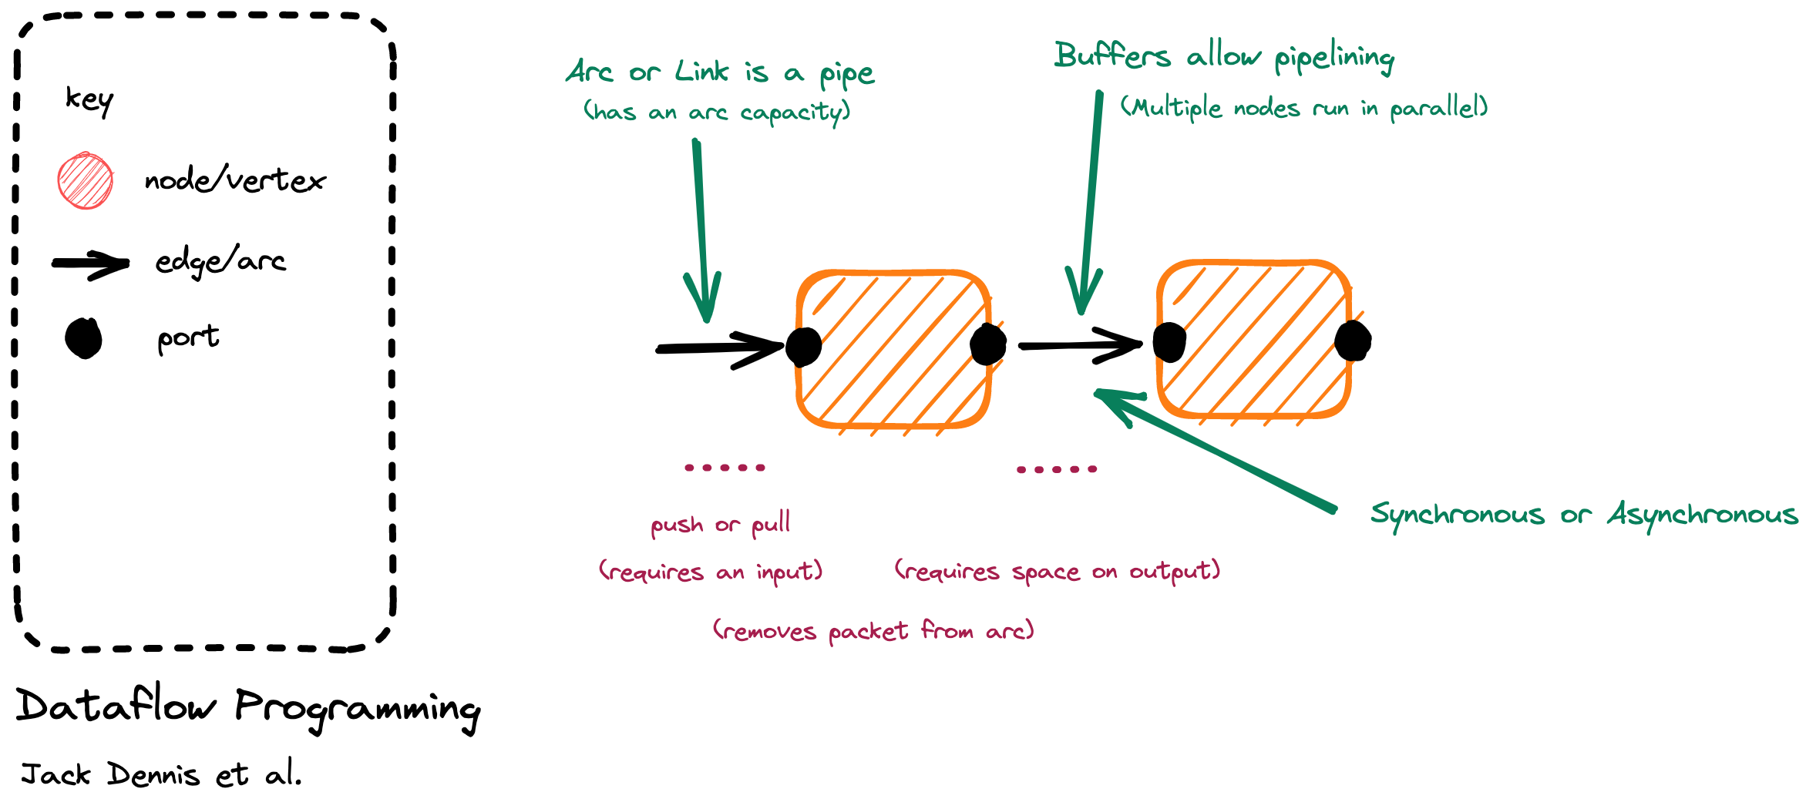
Node Lifetime: In ‘classic’ dataflow programming the lifetime of a node is from activation when there is work to do (push) or work is requested (pull) until it has pushed the answer.
Capacity: In dataflow programming we do not activate a node to read from the input, if there is no space on the output. (Infinite capacity links exist only in theory). This creates backpressure.
Notes:
Arc or links connect nodes
If the link is buffered it means that we can be asynchronous – raise our output event on to the buffer even if the downstream component is currently reacting to an earlier event. This allows us to parallelize, though throughput is limited to the slowest node
But for dataflow this is not a requirement, we may build a synchronous pipeline that has no buffering between components i.e. is single threaded
May be push => source is generating events (hot) like a mouse click and we ‘listen’ to them
May be pull => until we ask for events, by firing up a sink that pulls the chain of nodes, nothing is generated
If a buffer is full, we can’t output to it => this creates backpressure or load shedding

Slide 19
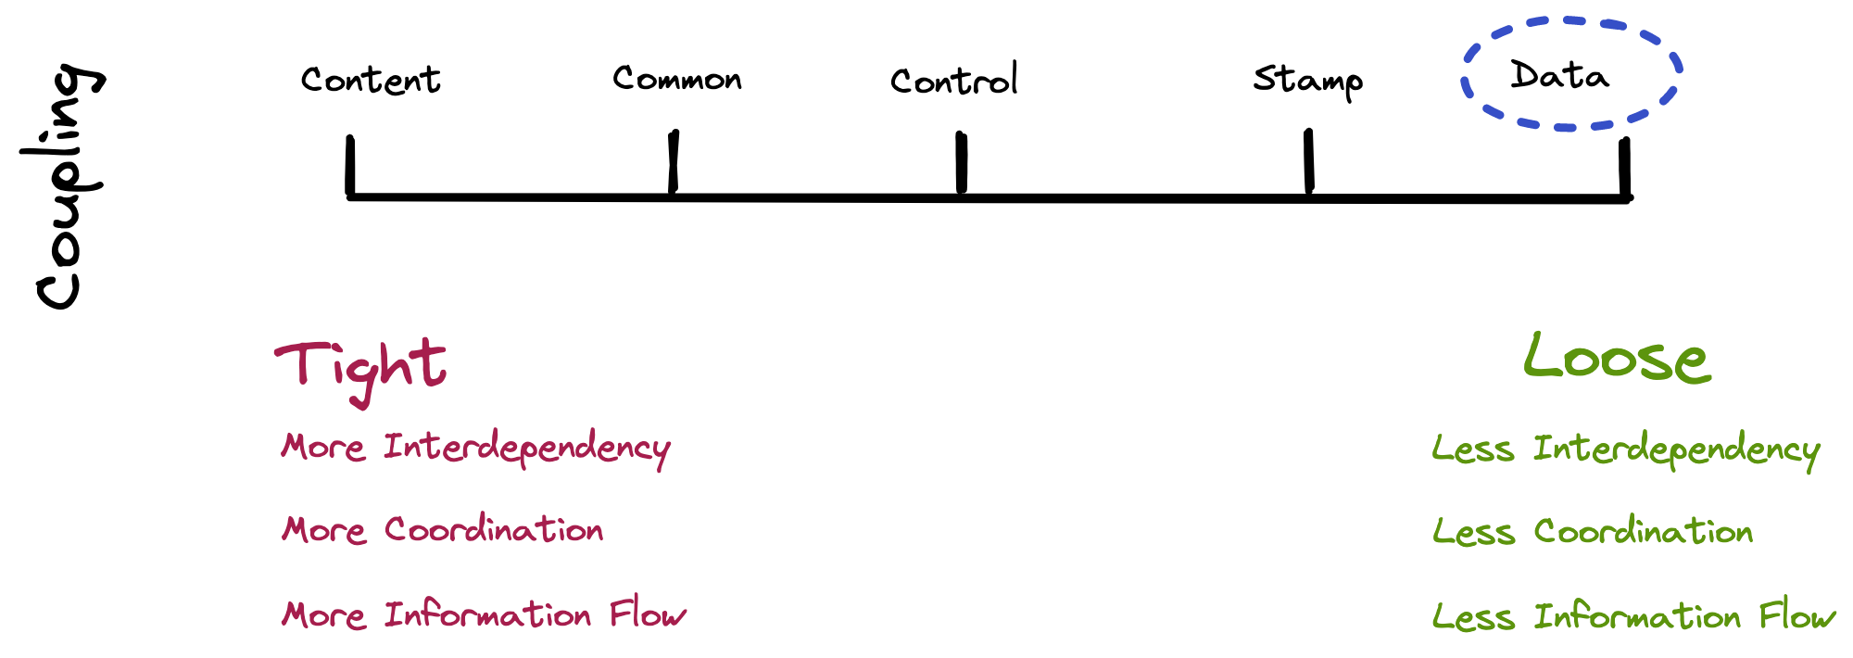
Notes:
Types of coupling
Conceptual model of coupling
Coupling can be "low" (also "loose" and "weak") or "high" (also "tight" and "strong"). Some types of coupling, in order of highest to lowest coupling, are as follows:
Procedural programming
A module here refers to a subroutine of any kind, i.e. a set of one or more statements having a name and preferably its own set of variable names.
Content coupling (high) Content coupling is said to occur when one module uses the code of another module, for instance a branch. This violates information hiding – a basic software design concept.
Common coupling: Common coupling is said to occur when several modules have access to the same global data. But it can lead to uncontrolled error propagation and unforeseen side-effects when changes are made.
Control coupling: Control coupling is one module controlling the flow of another, by passing it information on what to do (e.g., passing a what-to-do flag).
Stamp coupling: (data-structured coupling) Stamp coupling occurs when modules share a composite data structure and use only parts of it, possibly different parts (e.g., passing a whole record to a function that needs only one field of it). In this situation, a modification in a field that a module does not need may lead to changing the way the module reads the record.
Data coupling: Data coupling occurs when modules share data through, for example, parameters. Each datum is an elementary piece, and these are the only data shared (e.g., passing an integer to a function that computes a square root).
Object-oriented programming
Subclass coupling Describes the relationship between a child and its parent. The child is connected to its parent, but the parent is not connected to the child. Temporal coupling It is when two actions are bundled together into one module just because they happen to occur at the same time. In recent work various other coupling concepts have been investigated and used as indicators for different modularization principles used in practice.^{[5]}
Dynamic coupling
The goal of this type of coupling is to provide a run-time evaluation of a software system. It has been argued that static coupling metrics lose precision when dealing with an intensive use of dynamic binding or inheritance.^{[6]} In the attempt to solve this issue, dynamic coupling measures have been taken into account.
Semantic coupling
This kind of coupling considers the conceptual similarities between software entities using, for example, comments and identifiers and relying on techniques such as latent semantic indexing (LSI).
Logical coupling
Logical coupling (or evolutionary coupling or change coupling) exploits the release history of a software system to find change patterns among modules or classes: e.g., entities that are likely to be changed together or sequences of changes (a change in a class A is always followed by a change in a class B).

Slide 20
Agenda
T: 20
Objects
SOA
Reactive
Reactive Programming
Dataflow
Actors
Flow Based Programming
Reactive Systems
Message Passing
Resilience
Elasticity
Responsiveness

Slide 21
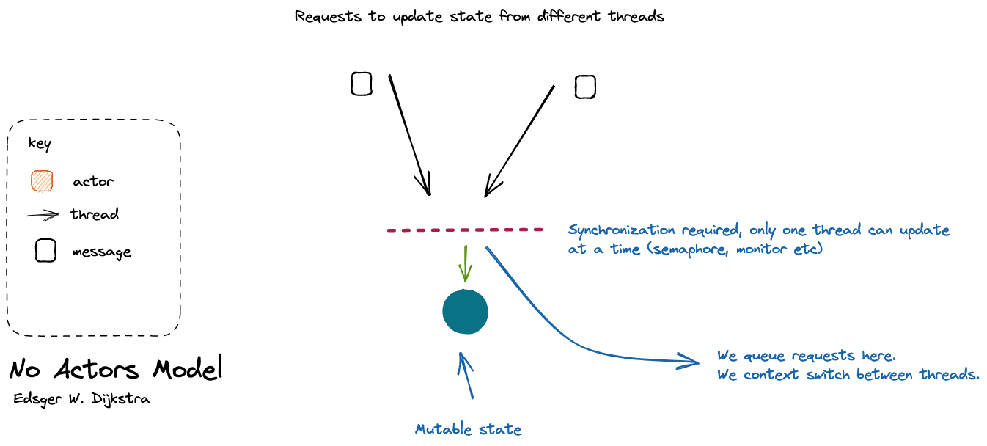

Slide 22
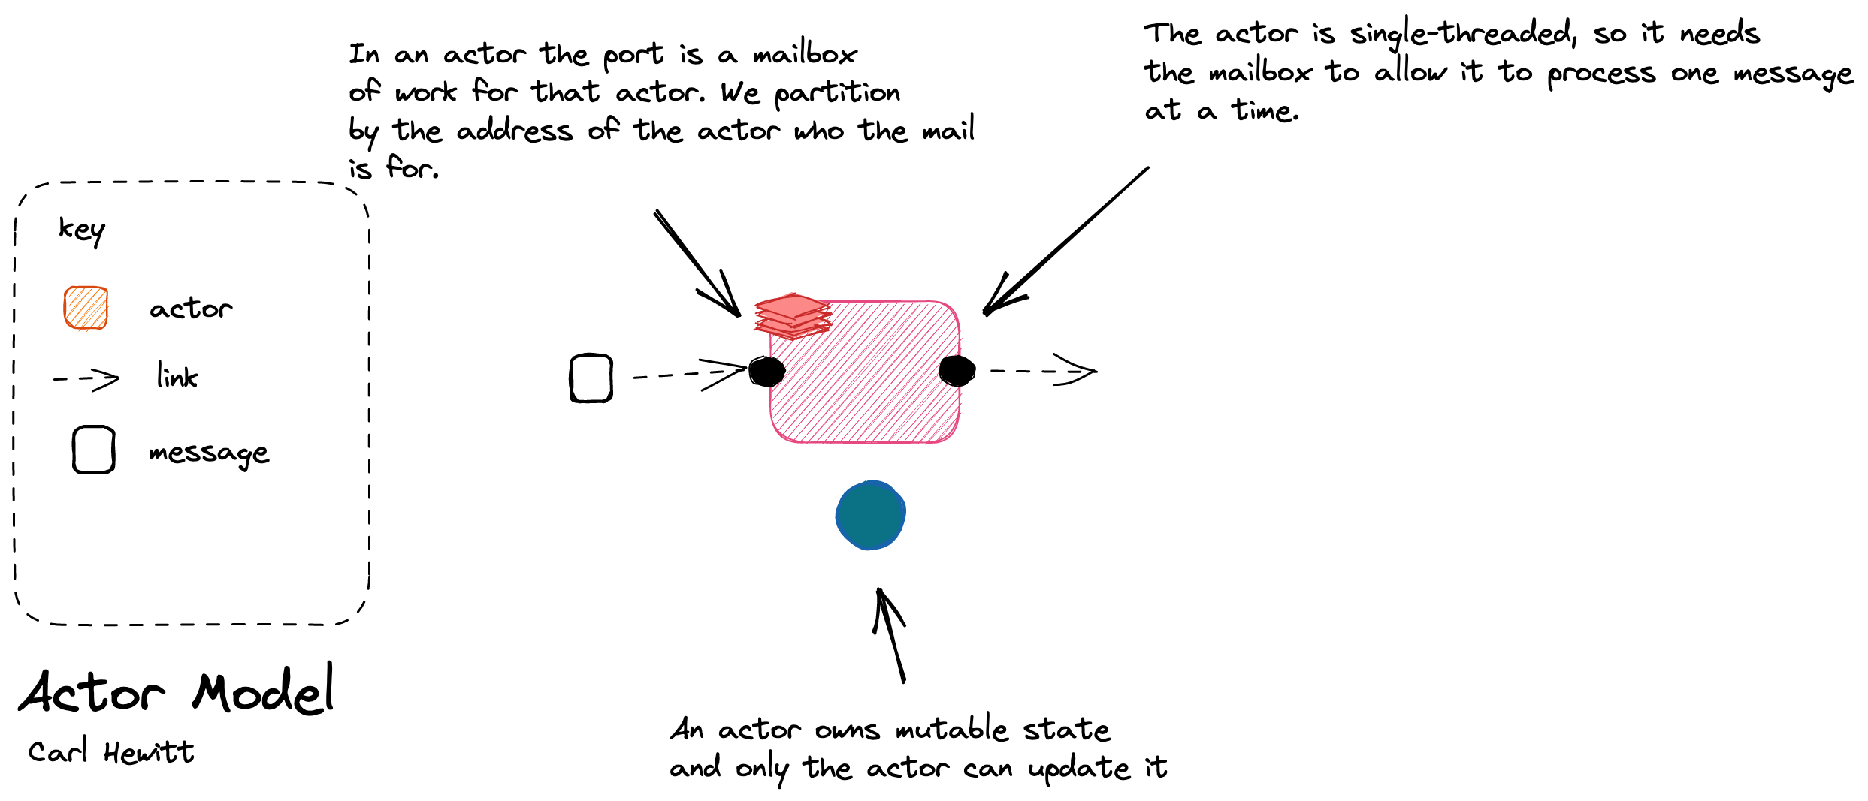
Concurrency: Hewitt’s motivation is to provide an alternative to synchronization primitives.

Slide 23
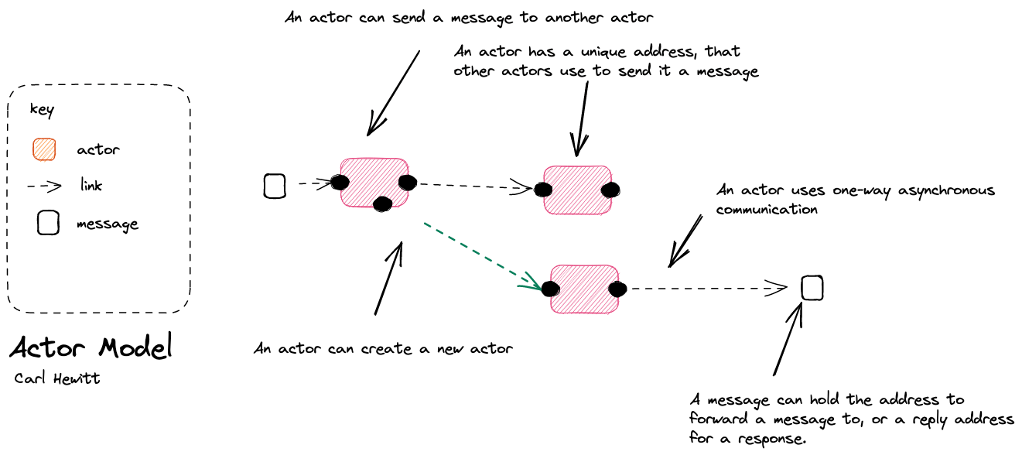
Notes:
Actor model is a mathematical model for dataflow programming. It provides constraints on what actors can do in response to a message – it is fundamentally driven by message passing.
Actors originated from the desire to solve the problem of concurrency – a lock or semaphore can protect data against concurrent access but become a bottleneck – in the actor model a node encapsulated the mutable state and serialized access to it instead.
An actor models’ graph is dynamic – that is the destination for a message is the address of an actor. The actor can obtain that information from one of three places: it had before reciept, on a message passed to it, because the actor activated the new actor it wants to send to. The passing of an address in the message, or creation of nodes allows the path of data to be determined dynamically
Examples: Erlang, Akka

Slide 24
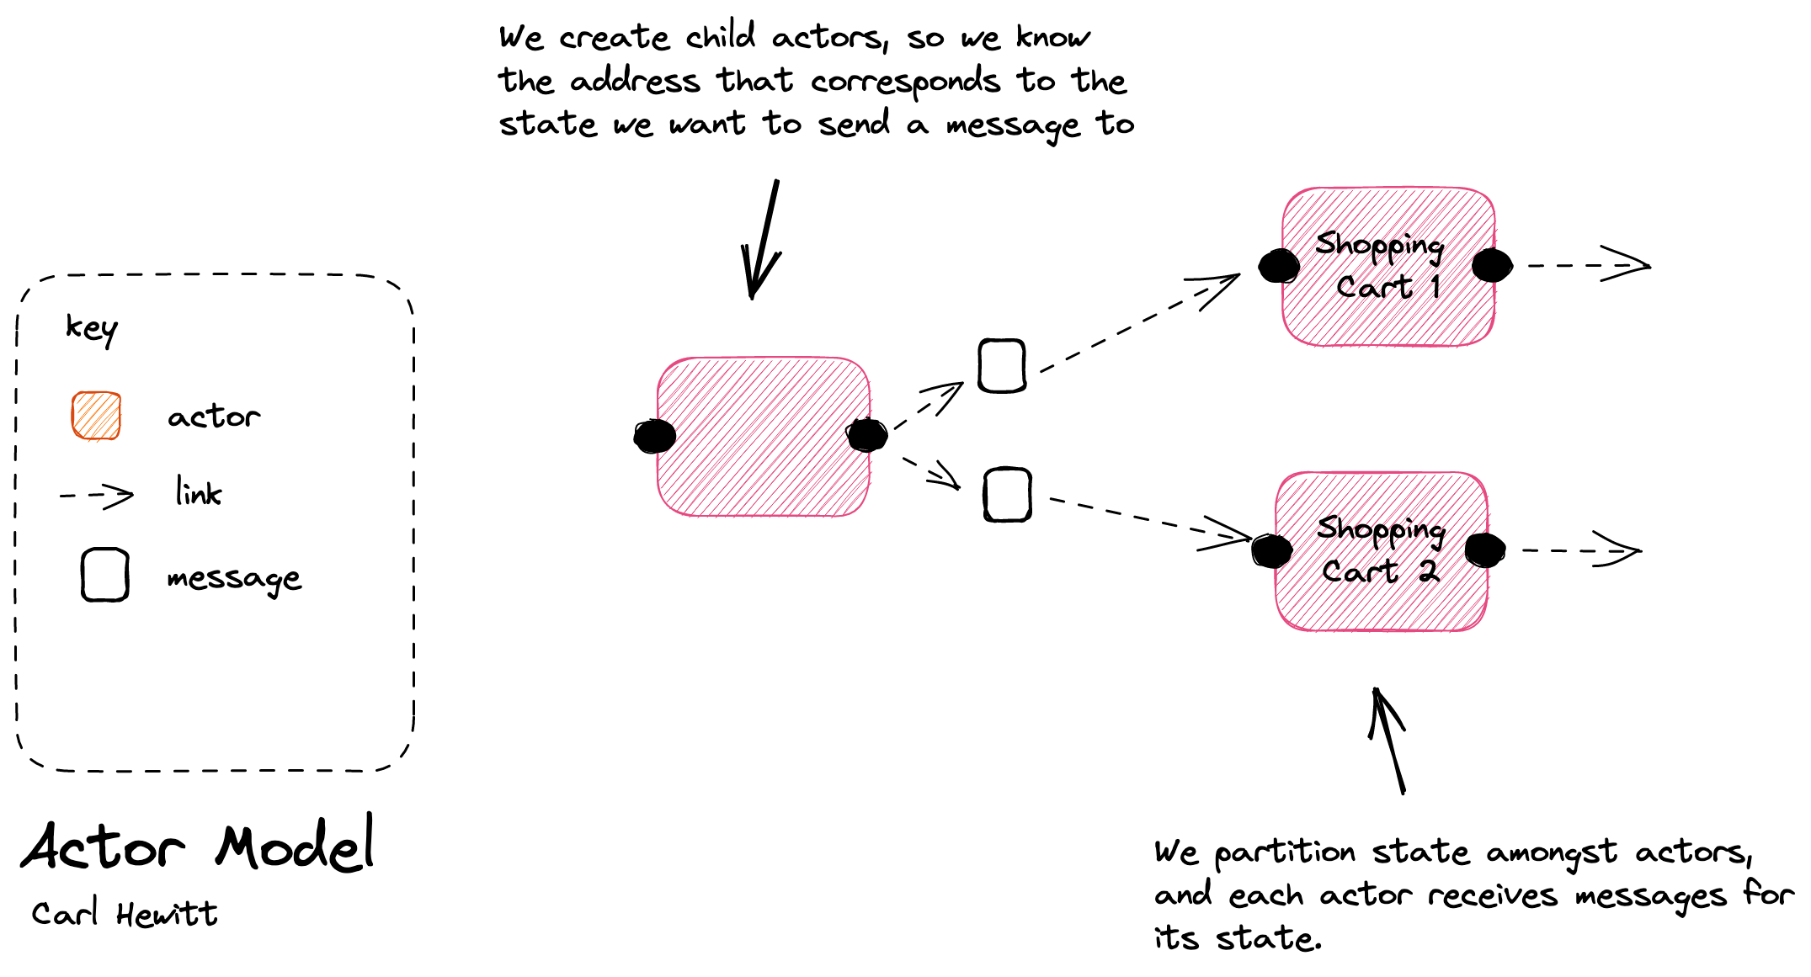
Scaling: Scaling to multiple actors requires partitioning messages for actors i.e. all messages for the same mutable to a single actor

Slide 25
Agenda
T: 25
Objects
SOA
Reactive
Reactive Programming
Dataflow
Actors
Flow Based Programming
Reactive Systems
Message Passing
Resilience
Elasticity
Responsiveness

Slide 26
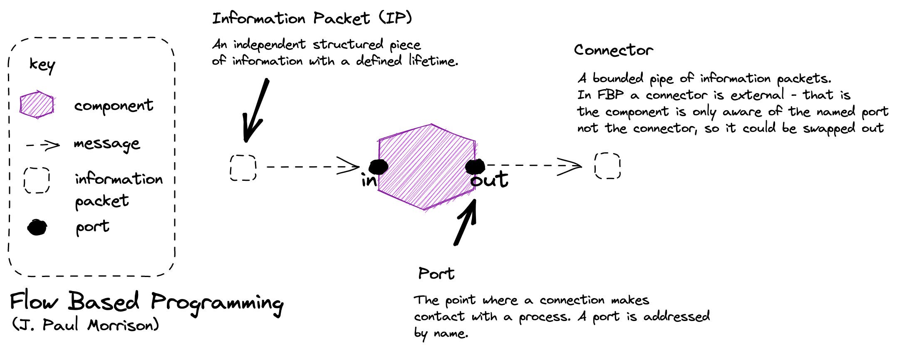
Flow-Based Programming (FBP) is a subclass of DFP. While DFP can be synchronous or asynchronous, FBP is always asynchronous. FBP allows multiple input ports, has bounded buffers and applies back pressure when buffers fill up.

Slide 27
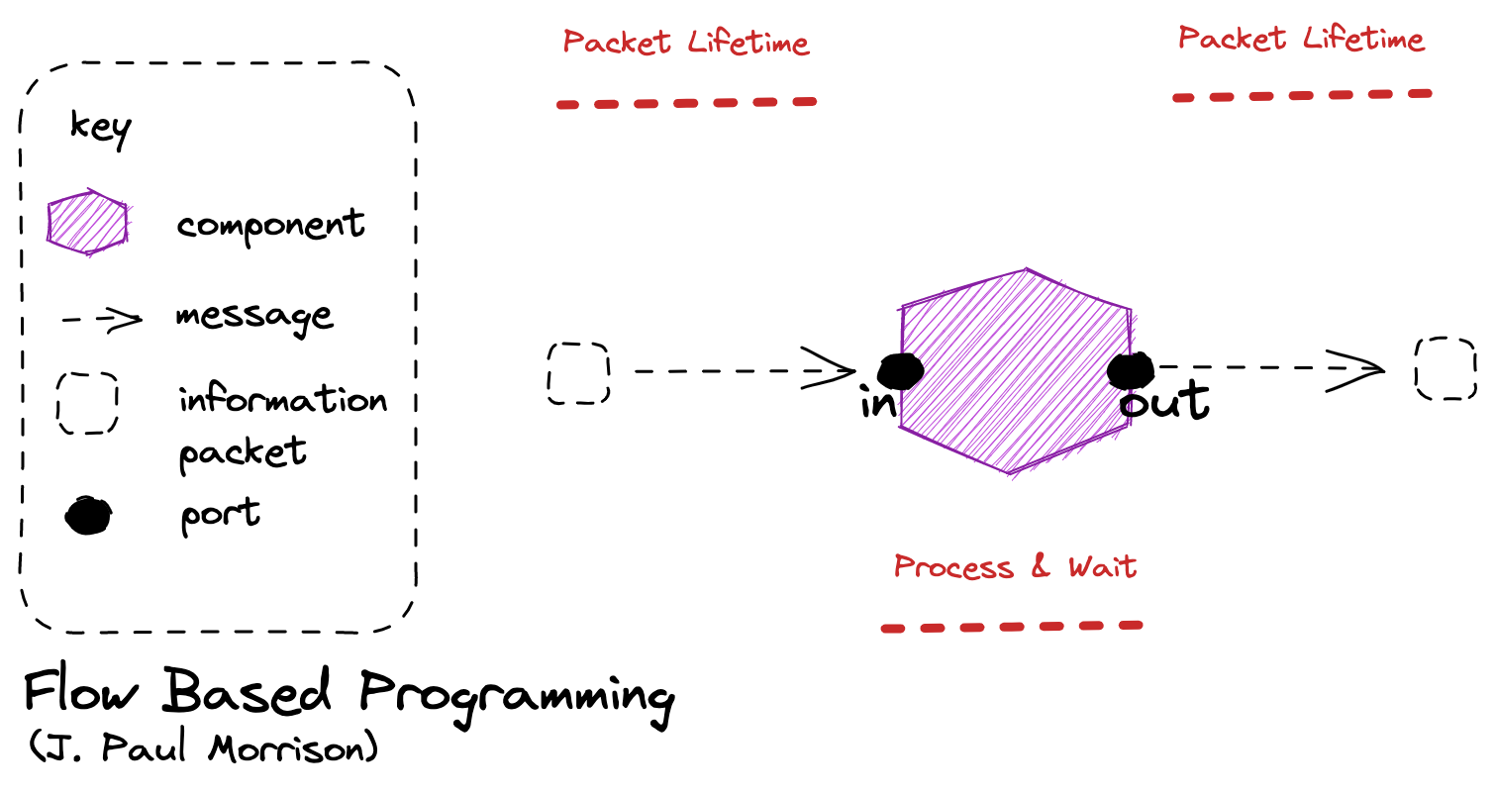
Capacity: In flow-based programming a component can test to see if it can send to out (backpressure), and if not decide whether to ignore (load shedding) or even halt.
Node Lifetime: In flow base programming the a node can remain running whilst there is work on an input queue, can can suspend instead of terminate if there is no work on its connector. We may receive an explicit signal to indicate we should stop.

Slide 28
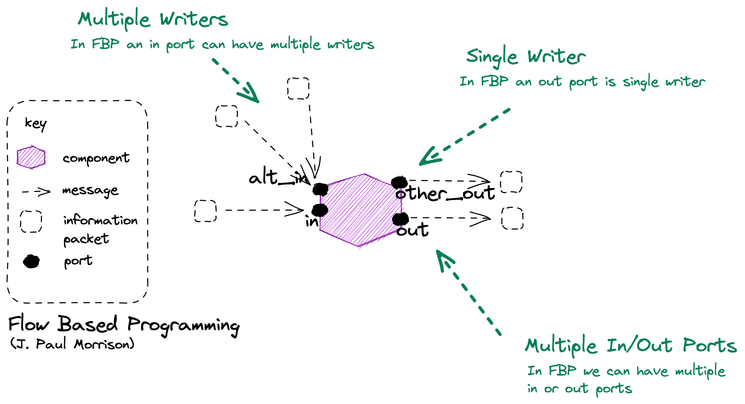

Slide 29
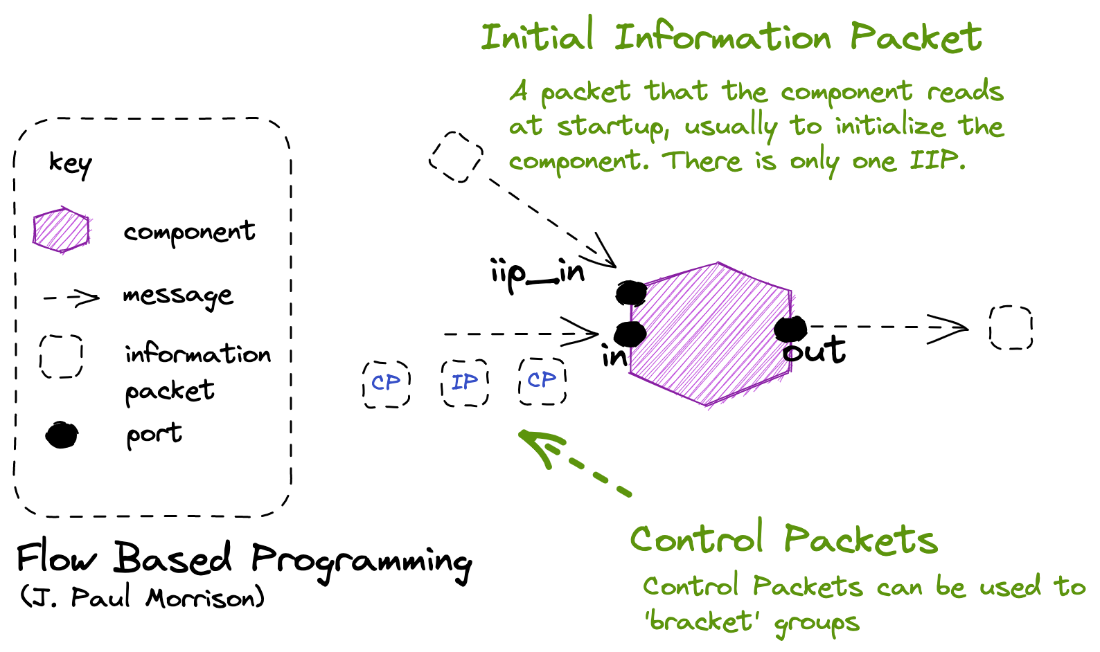

Slide 30
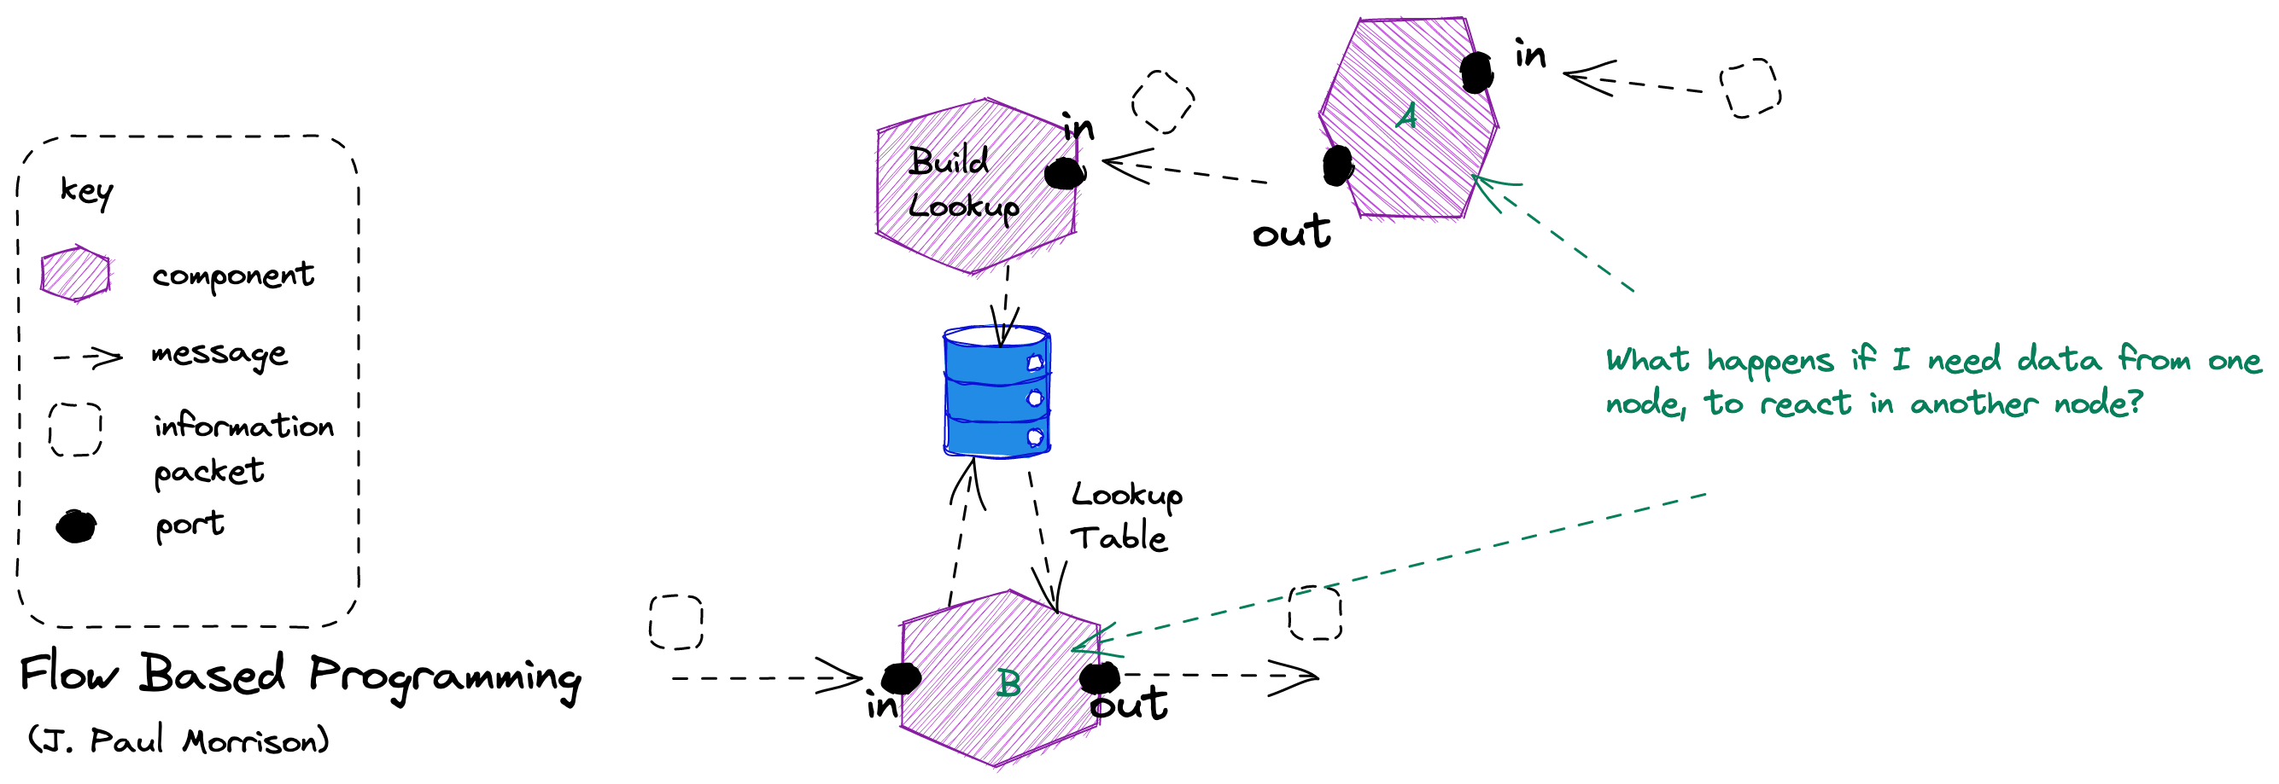

Slide 31
Agenda
T: 30
Objects
SOA
Reactive
Reactive Programming
Dataflow
Actors
Flow Based Programming
Reactive Systems
Message Passing
Resilience
Elasticity
Responsiveness

Slide 32
Value
Responsive
Form
Elastic
Resilient
Means
Message Driven

Slide 33
Agenda
T: 35
Objects
SOA
Reactive
Reactive Programming
Dataflow
Actors
Flow Based Programming
Reactive Systems
Message Passing
Resilience
Elasticity
Responsiveness

Slide 34
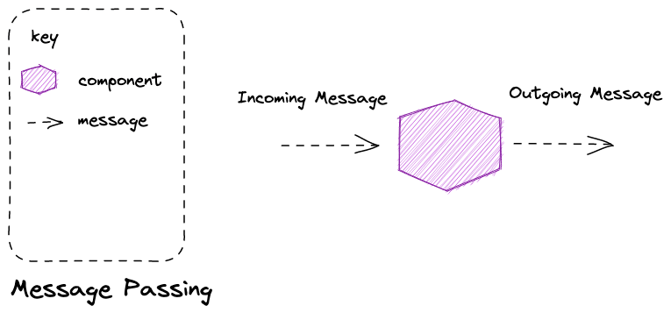
Message Passing is an asynchronous method of communication – both parties do not have to be simultaneously present for communication to occur, instead mail is delivered to ‘mailbox’ of some form for later retrieval.
Notes:
Message passing is a technique for invoking behavior (i.e., running a program) on a computer. In contrast to the traditional technique of calling a program by name, message passing uses an object model to distinguish the general function from the specific implementations. The invoking program sends a message and relies on the object to select and execute the appropriate code. The justifications for using an intermediate layer essentially falls into two categories: encapsulation and distribution.

Slide 35
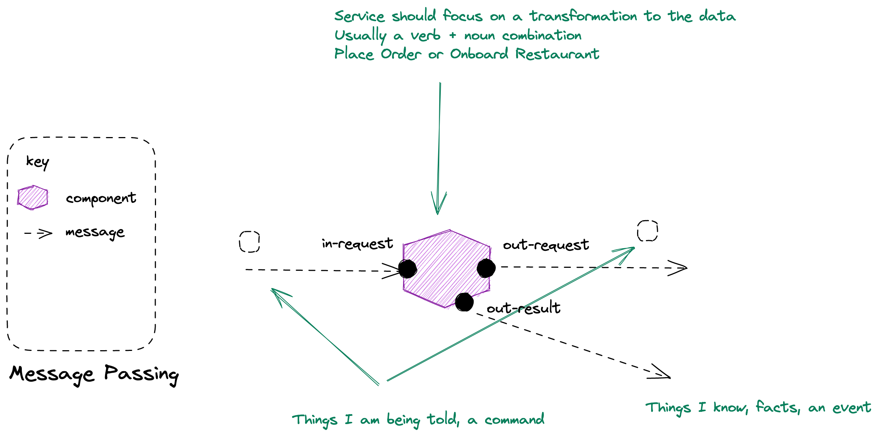
Notes:
Message passing is a technique for invoking behavior (i.e., running a program) on a computer. In contrast to the traditional technique of calling a program by name, message passing uses an object model to distinguish the general function from the specific implementations. The invoking program sends a message and relies on the object to select and execute the appropriate code. The justifications for using an intermediate layer essentially falls into two categories: encapsulation and distribution.

Slide 36
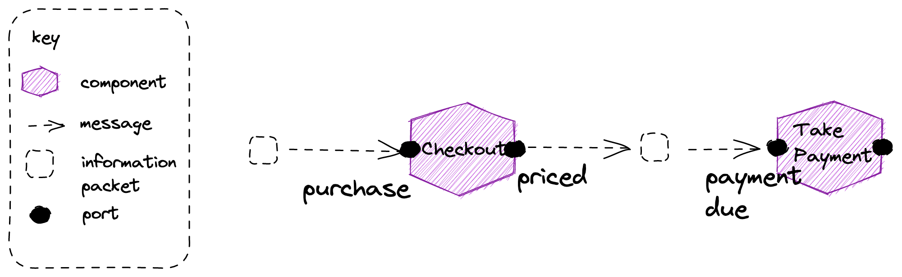
Coordinate Dataflow A reactive principle where we “orchestrate a continuous steady flow of information” focusing on division by behavior, not structure
Partitioning Partition to take advantage of parallelism in the system, tasks that could be done concurrently with each other
Notes:
Dataflow Reactive architectures inherit from dataflow programming – we conceive of our application as a graph of nodes that perform operations on data flowing through the system
Reactive shines in the creation of data-driven applications through the composition of components in workflows. Thinking in terms of dataflow, how the data flows through the system, what behavior it is triggering and where, and how components are causally related allows focusing on the behavior instead of the only on the structure. Orchestrate workflow and integration by letting components (or subsystems) subscribe to each other’s event streams, consuming on-demand the asynchronously published facts.

Slide 37
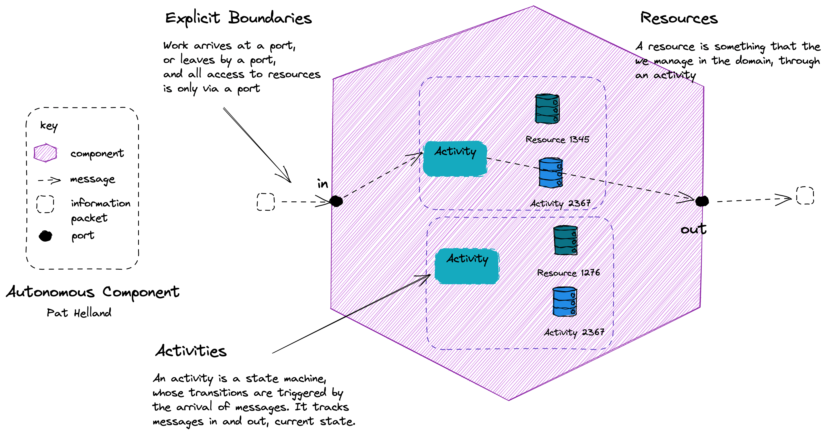
Notes:
Assert Autonomy: Design components that act independently and interact collaboratively. In Reactive applications, autonomy is achieved by clearly defining the component boundaries, who owns what data and how the owners make it available, and by designing them such that each party is afforded the necessary degree of freedom to make its own decisions.
Actors are ONE option: although actor frameworks are one option, reactive applications like this can use many implementation approaches

Slide 38
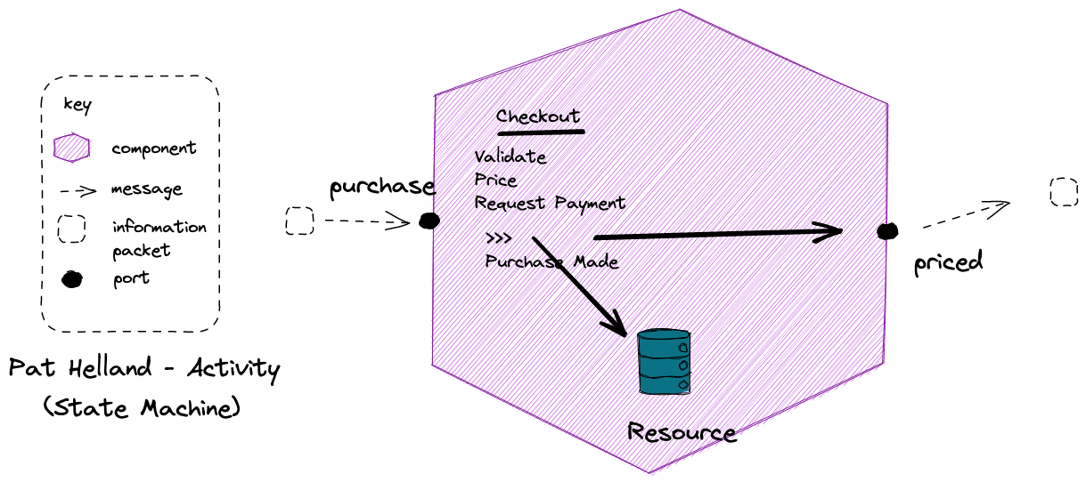
Isolate Mutations A reactive pattern where we “contain and isolate mutable state”. The mutable state lives within a component that has a defined boundary.
Notes:
Resource might be something like vouchers here; once you have used a voucher code for a discount, it can’t be reused by that customer

Slide 39
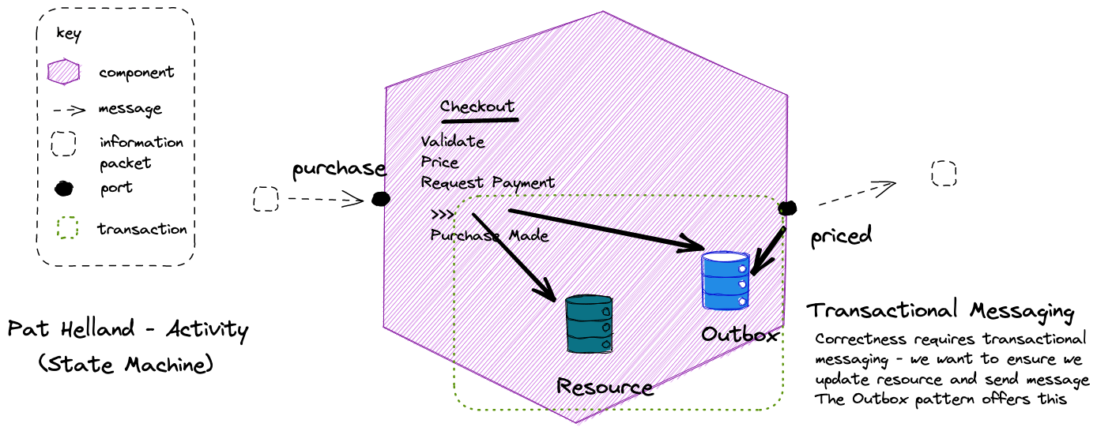

Slide 40
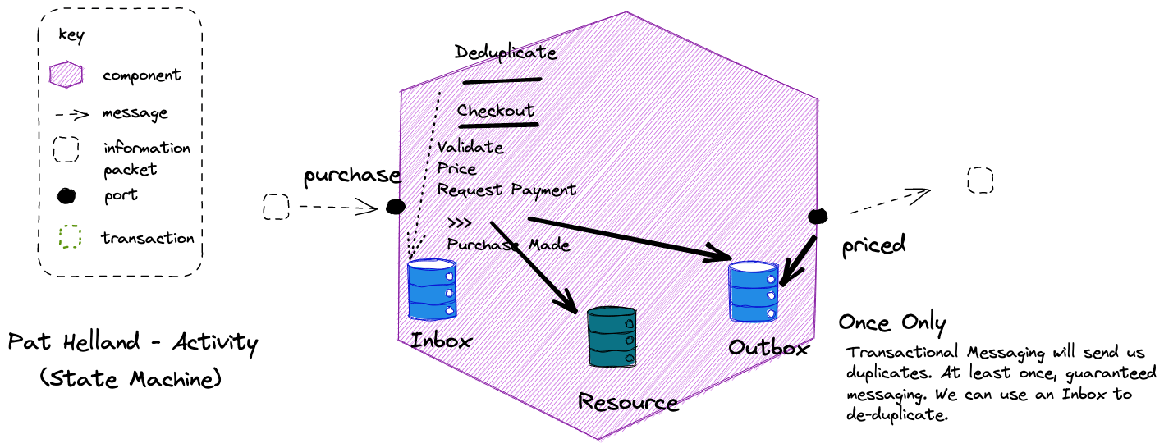

Slide 41
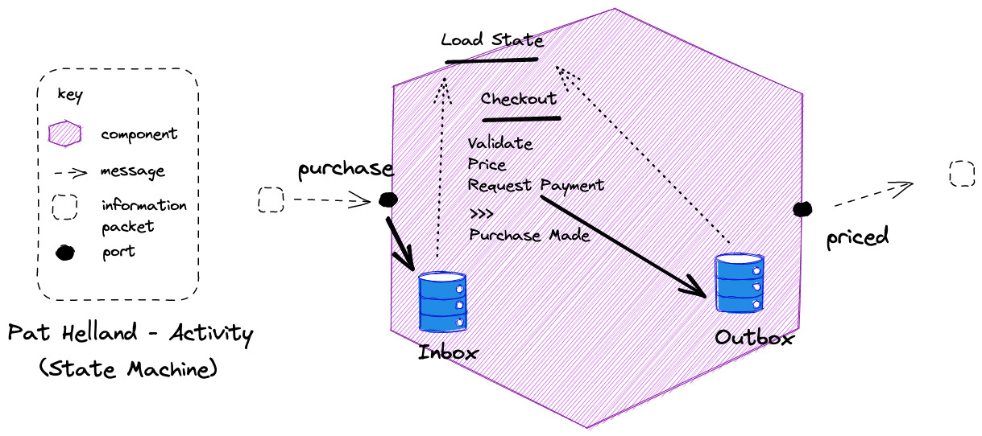
It is possible to calculate activity state by comparing the inbox and outbox to determine where a flow reached, in the event of failure, over storing current state.

Slide 42
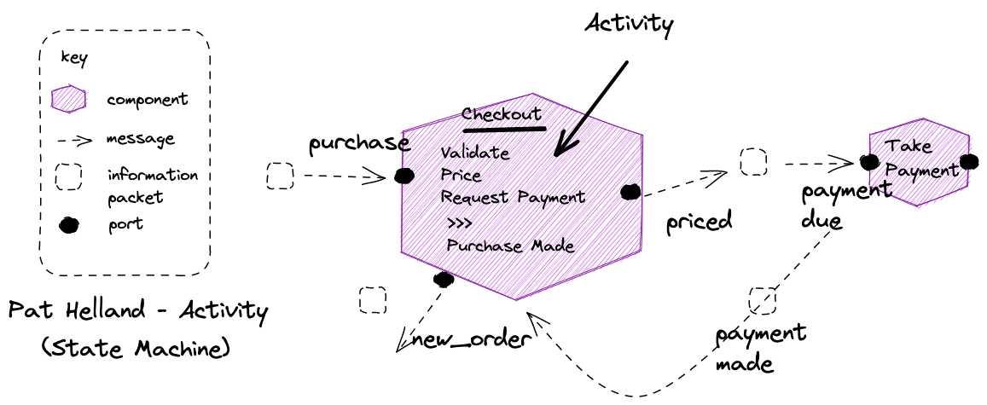
Notes:
No need to block for request-response, we get a reply via a message too

Slide 43
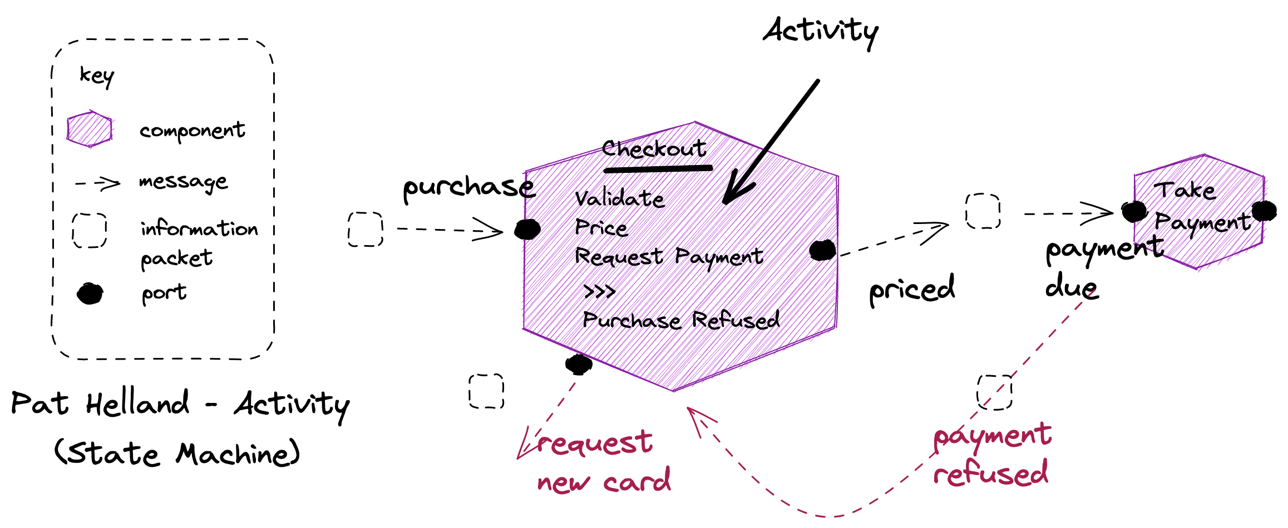
Notes:
Unhappy paths are also messages, just a different message, usually to a different port

Slide 44
Agenda
T: 45
Objects
SOA
Reactive
Reactive Programming
Dataflow
Actors
Flow Based Programming
Reactive Systems
Message Passing
Resilience
Elasticity
Responsiveness

Slide 45
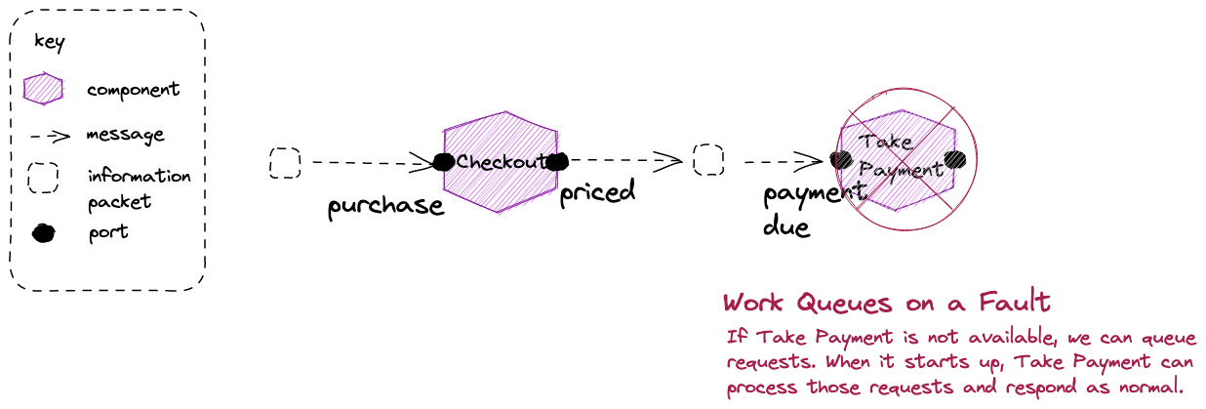
Bulkheads: In an asynchronous conversation a fault does not propagate back up the chain – we have a bulkhead that protects us against failure
Notes:
With asynchronous message passing the receiving object can be down or busy when the requesting object sends the message. Continuing the function call analogy, it is like a function call that returns immediately, without waiting for the called function to complete. Messages are sent to a queue where they are stored until the receiving process requests them. The receiving process processes its messages and sends results to a queue for pickup by the original process (or some designated next process).^{[3]}
Asynchronous messaging requires additional capabilities for storing and retransmitting data for systems that may not run concurrently, and are generally handled by an intermediary level of software (often called middleware); a common type being Message-oriented middleware (MOM).

Slide 46
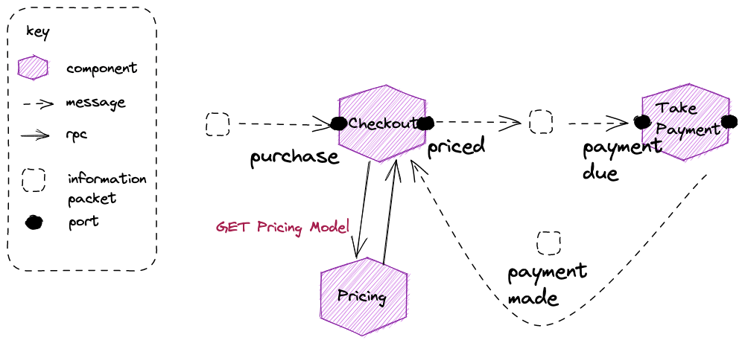
Lookups: We may not have all the data in our component needed to process a message we receive - here we need the prices for your purchase – which implies a lookup such as an HTTP GET to the owner

Slide 47
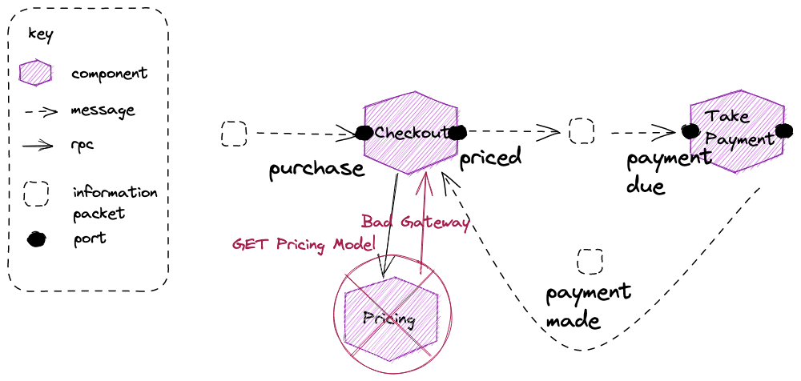
Don’t Do Gets: Don’t use a GET to retrieve data from another service in a reactive architecture. We must use message passing.

Slide 48
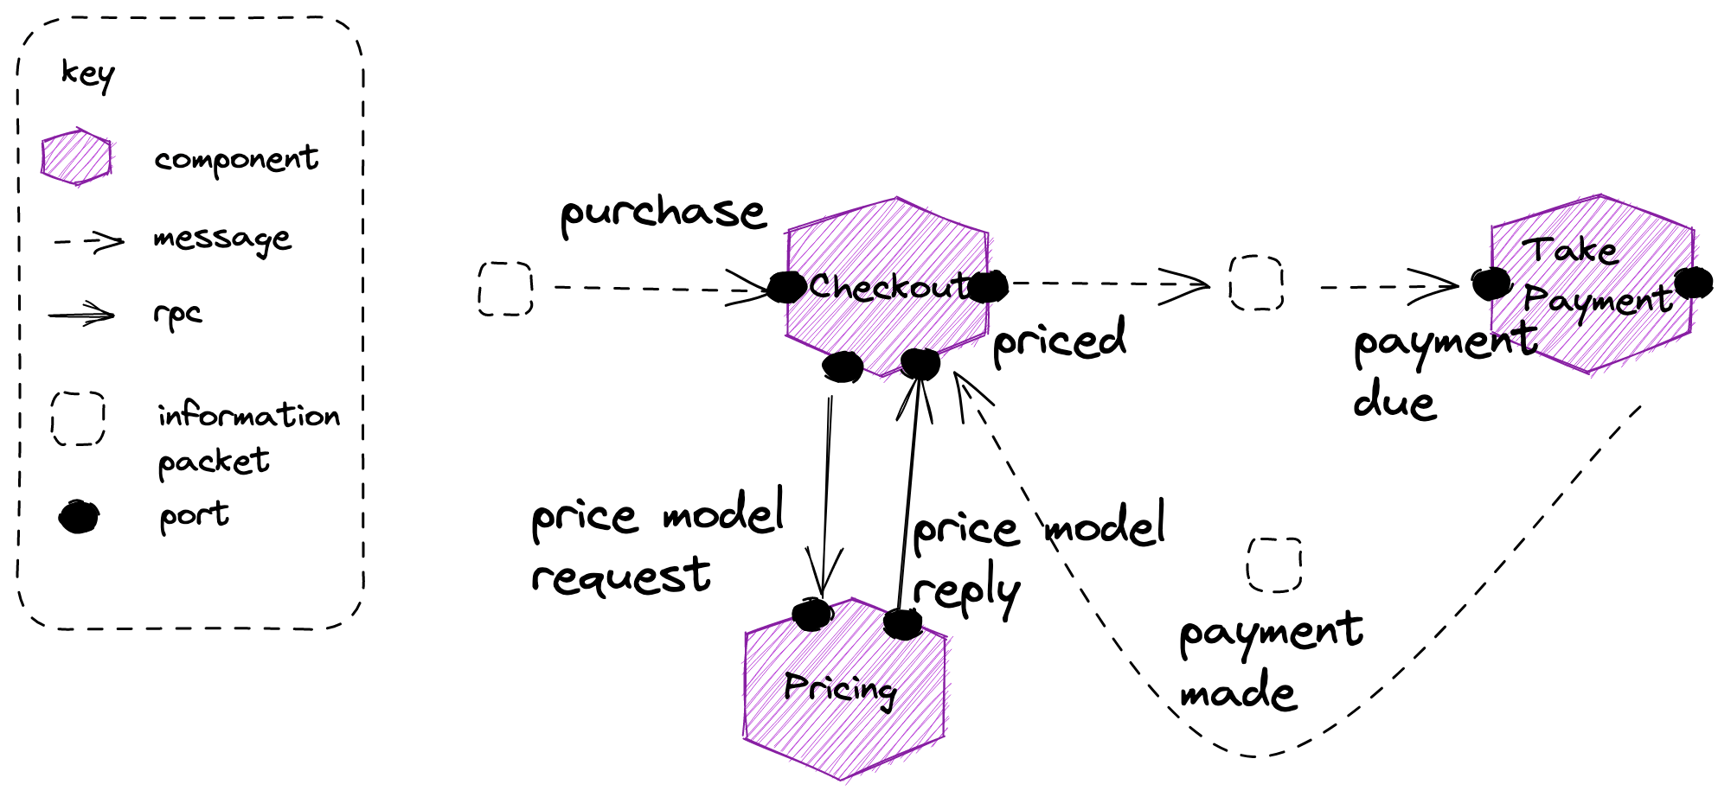
Notes:
We can send a message to request the pricing model, and get a reply, over an asynchronous channel.
This means we need to suspend pricing whilst we wait for a response with the model to come back, and then load the current pricing activity via correlation id

Slide 49
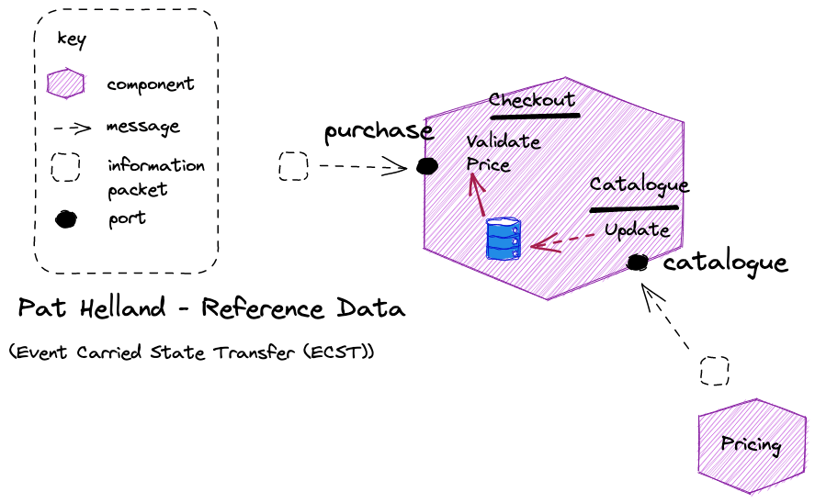
ECST: Subscribes to events from a component to builds a forward cache ( projection) of that components published data, and uses it for lookups
Notes:
If we remember FBP lookups, we can simplify and avoid the need to suspend the pricing operation, by having the required information ahead of time

Slide 50
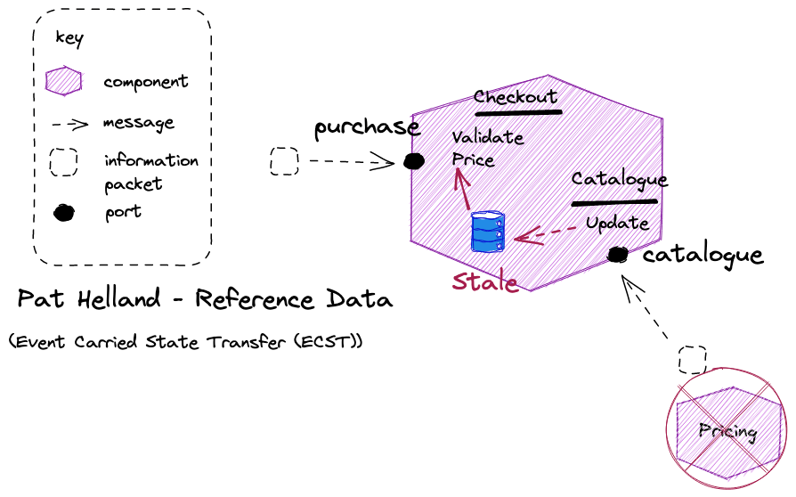
Tailor Consistency: Reactive advises choosing the consistency you need for its trade-offs. Usually we can tolerate eventual consistency – nearly everything is to an extent its just degrees of latency – to gain availability
Eventual Consistency: We are eventual consistent, stale, but continue to be able to lookup. Accepting eventual consistency is a reactive principle.

Slide 51
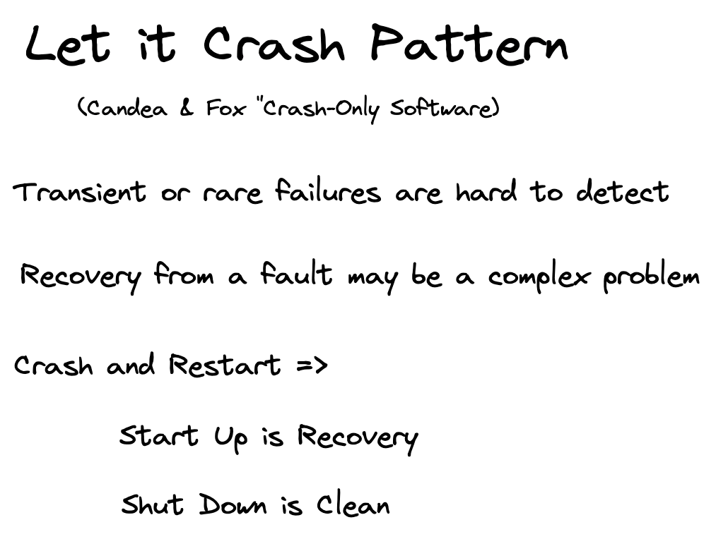

Slide 52
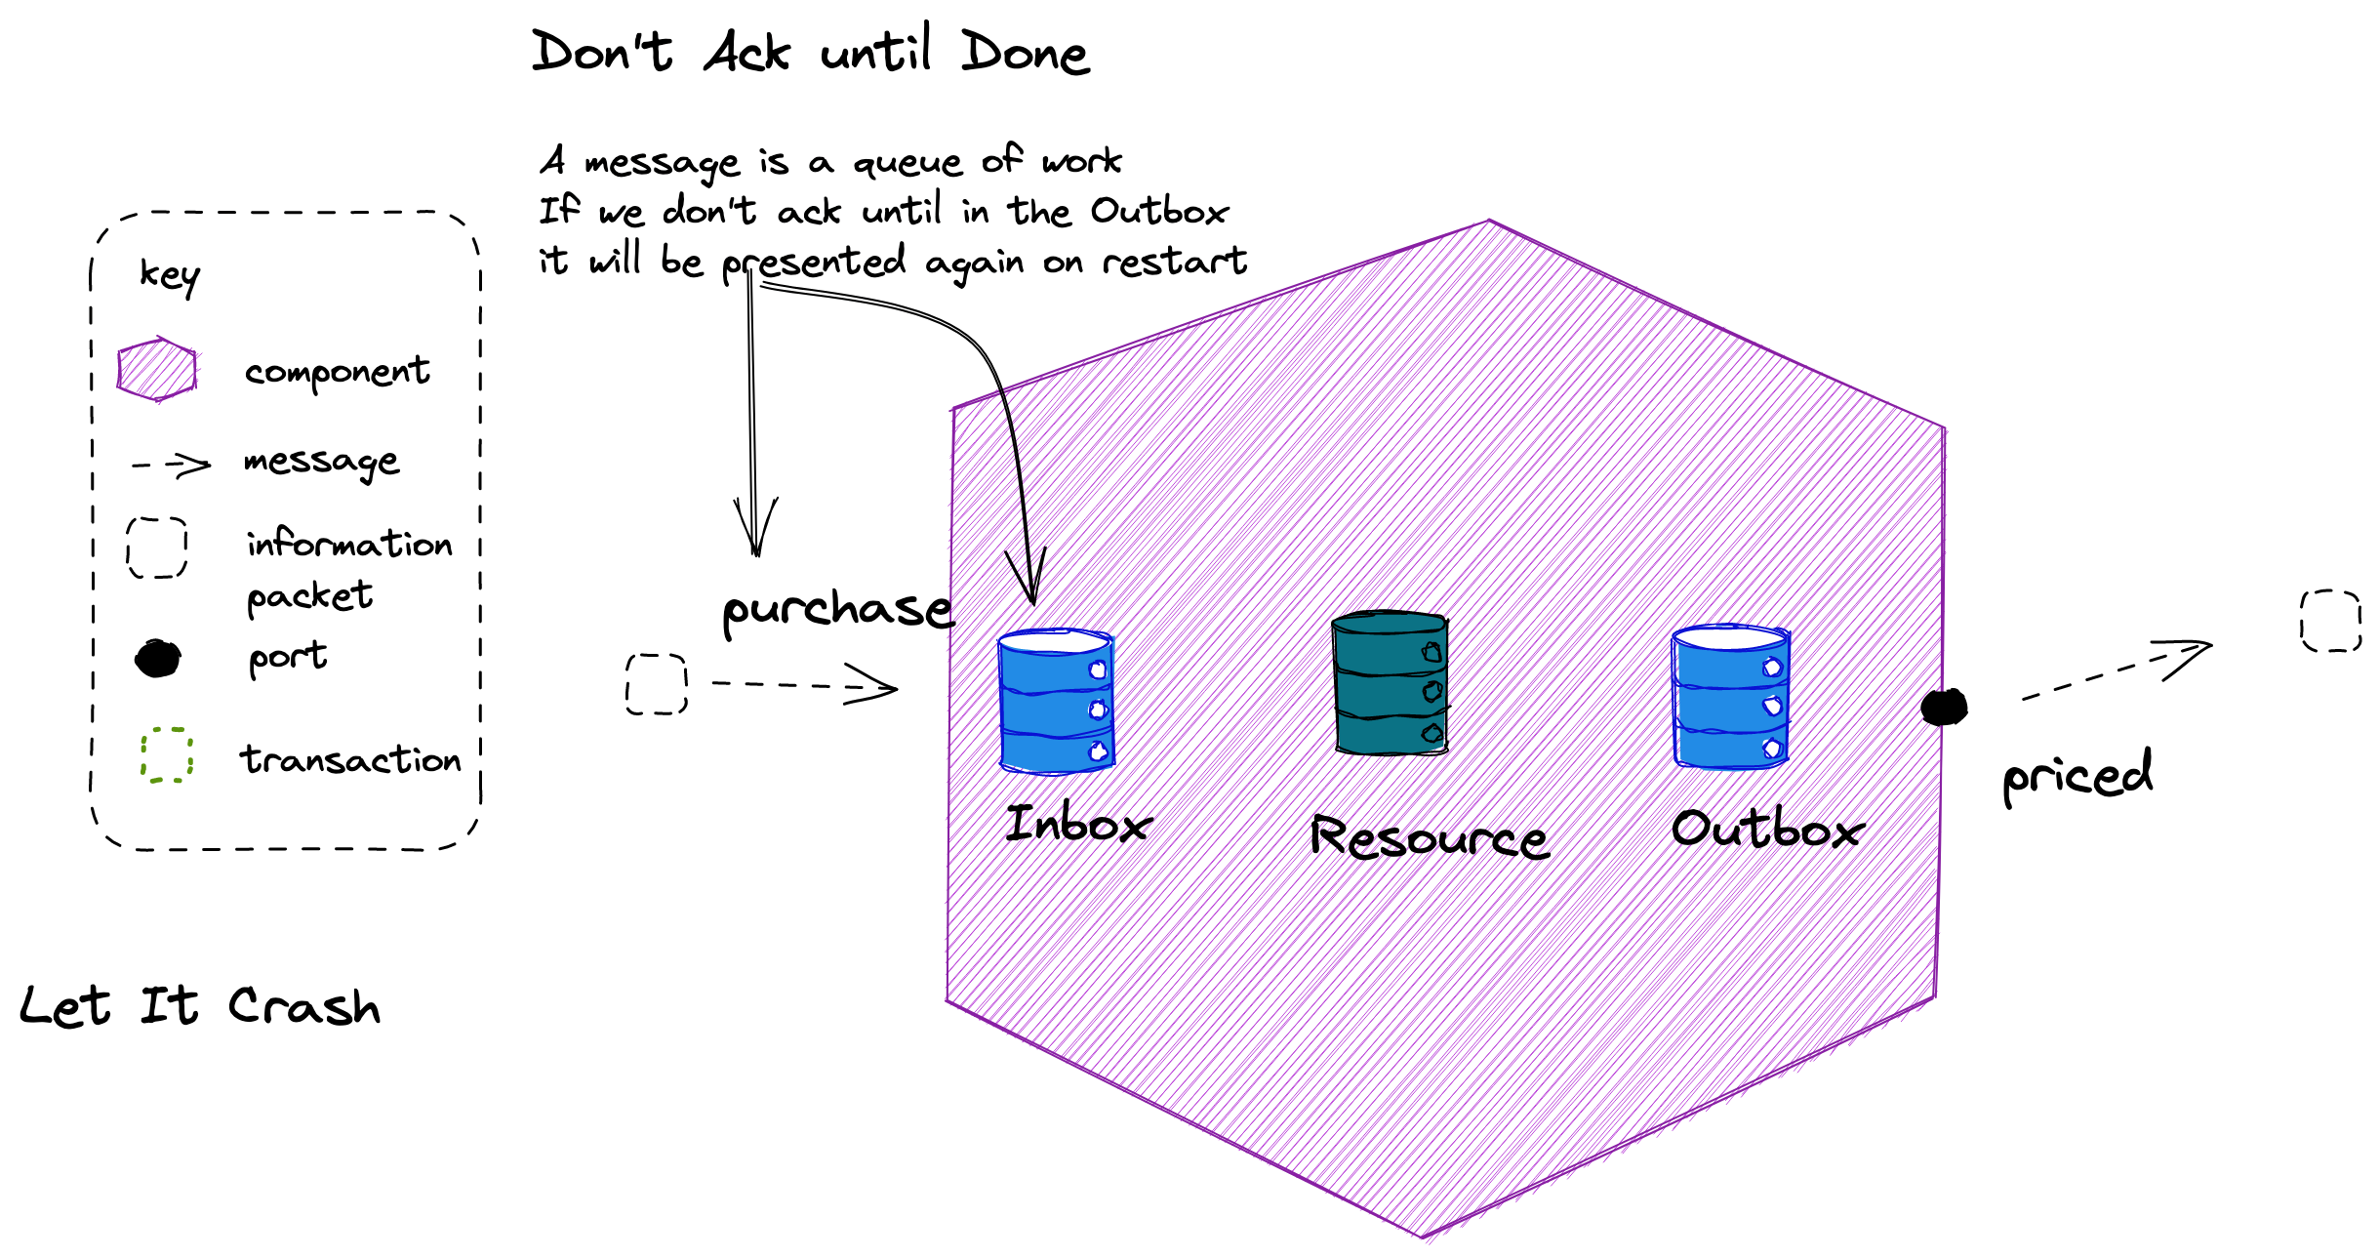

Slide 53
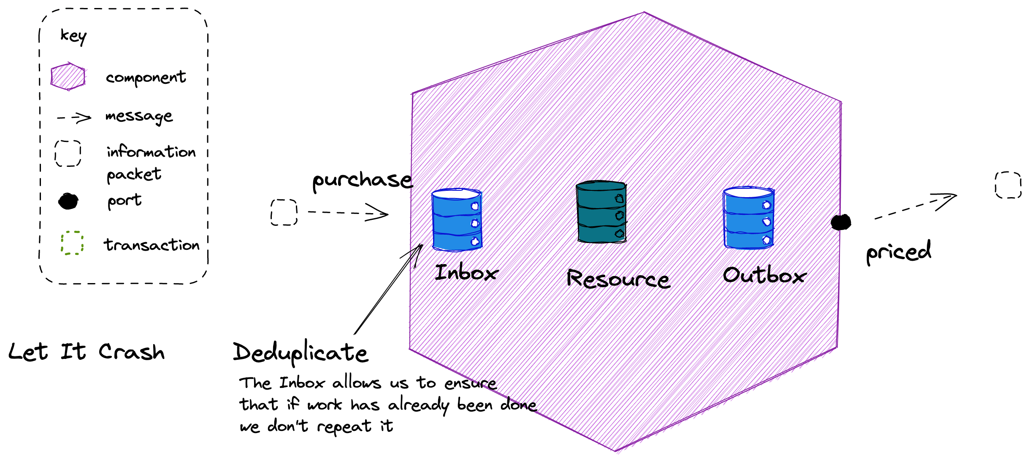

Slide 54
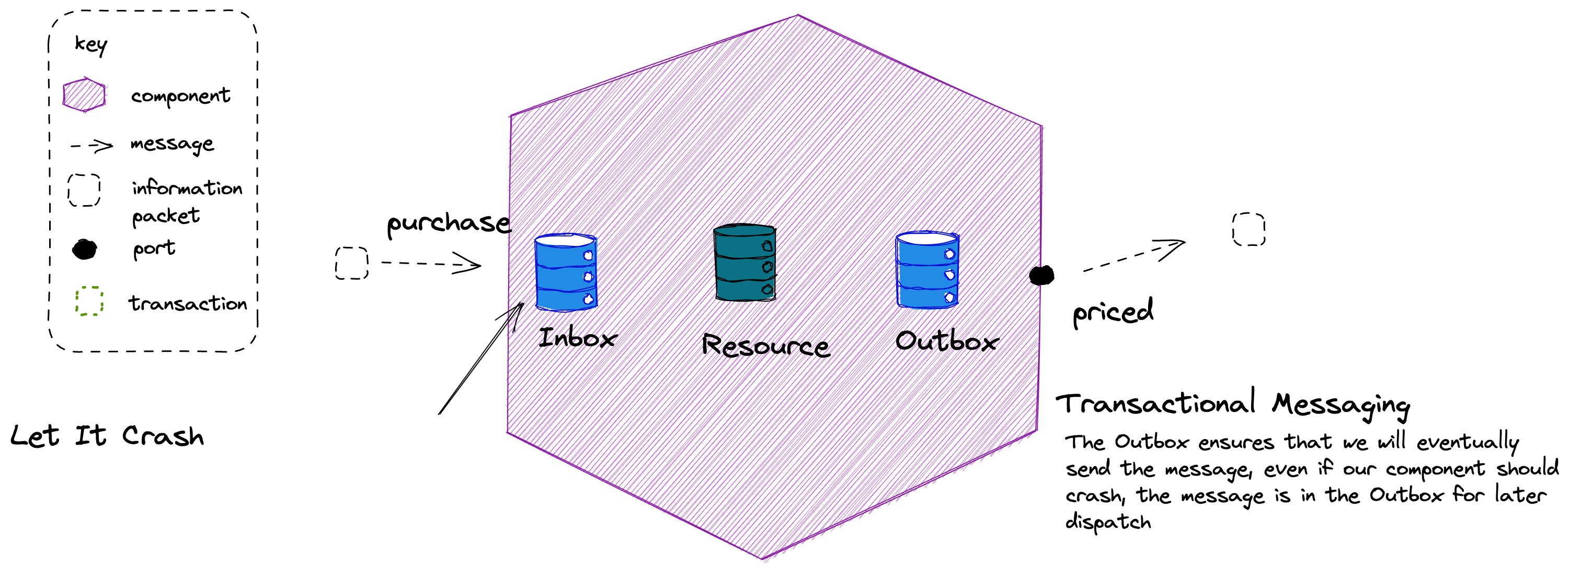

Slide 55
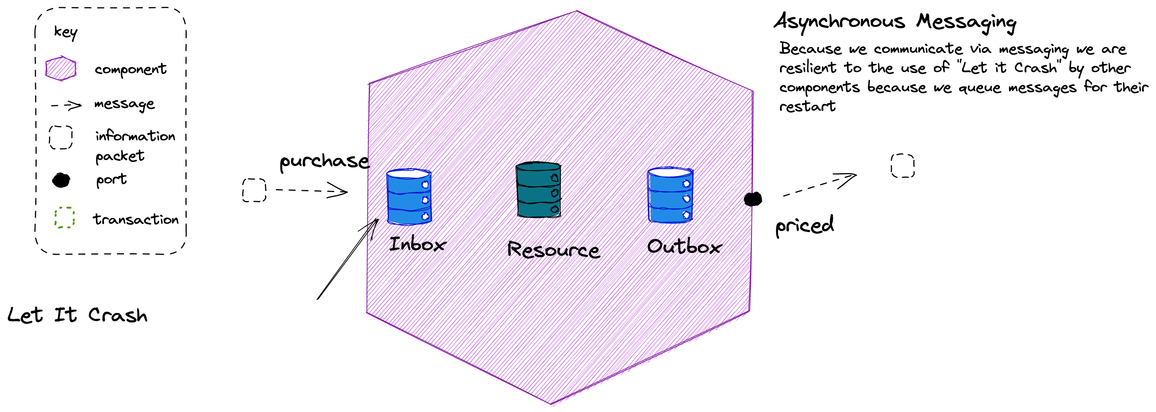
ECST: Don’t forget, because we use ECST and not a GET, we support “Let it Crash” by components where we need to lookup

Slide 56
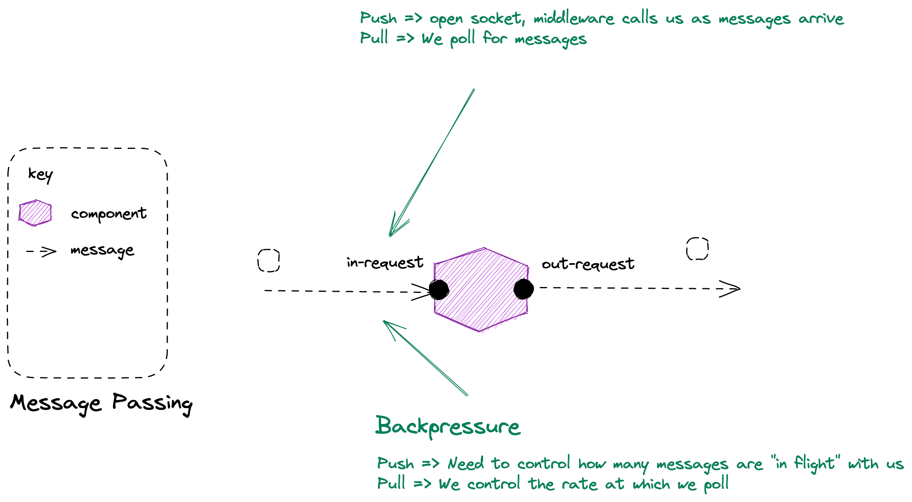

Slide 57
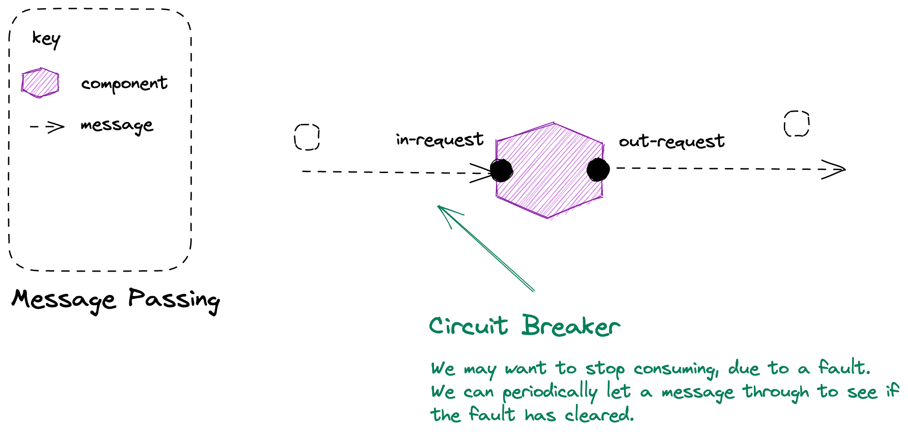

Slide 58
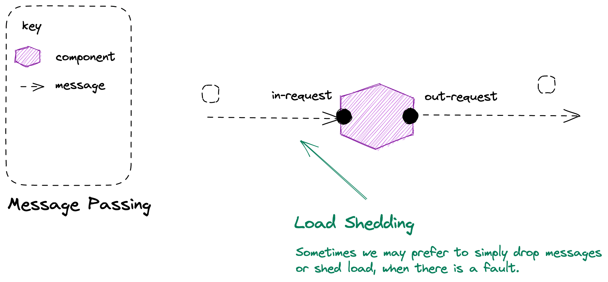
Notes:
Back-Pressure and Load-Shedding
If you have no buffers, or your buffers are full then something has to be sacrificed. Either we need to slow down the producer (back-pressure) or we need to discard data (load-shedding).
Back-pressure is the concept of the producer getting backwards pressure from the pipe it shoves data down, forcing it to slow down until the pressure alleviates. Back pressure is a good option when data loss is unacceptable and the extra latency is not an issue.
Load-shedding means we discard data in order to keep up. This can be a great option for metrics that are published at high velocity. We might receive a metric at a 1000 updates per second, but only need 10 per second in order to meet our SLA. We can even prioritize our load-shedding intelligently so we only discard less valuable data.

Slide 59
Agenda
T: 50
Objects
SOA
Reactive
Reactive Programming
Dataflow
Actors
Flow Based Programming
Reactive Systems
Message Passing
Resilience
Elasticity
Responsiveness

Slide 60
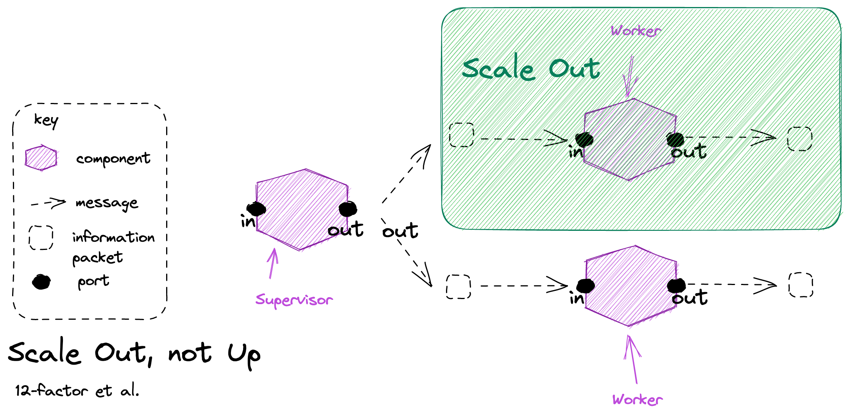

Slide 61
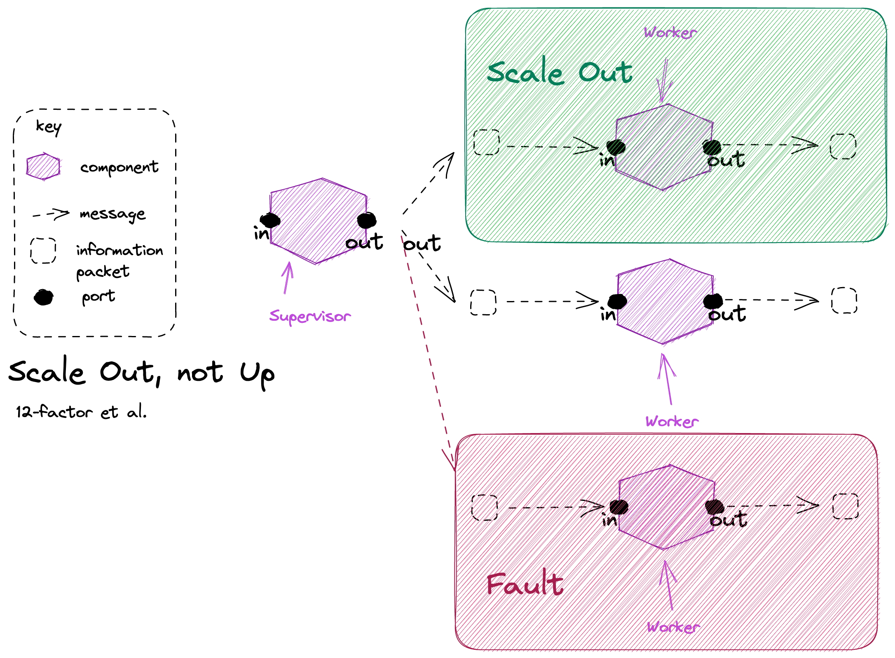

Slide 62
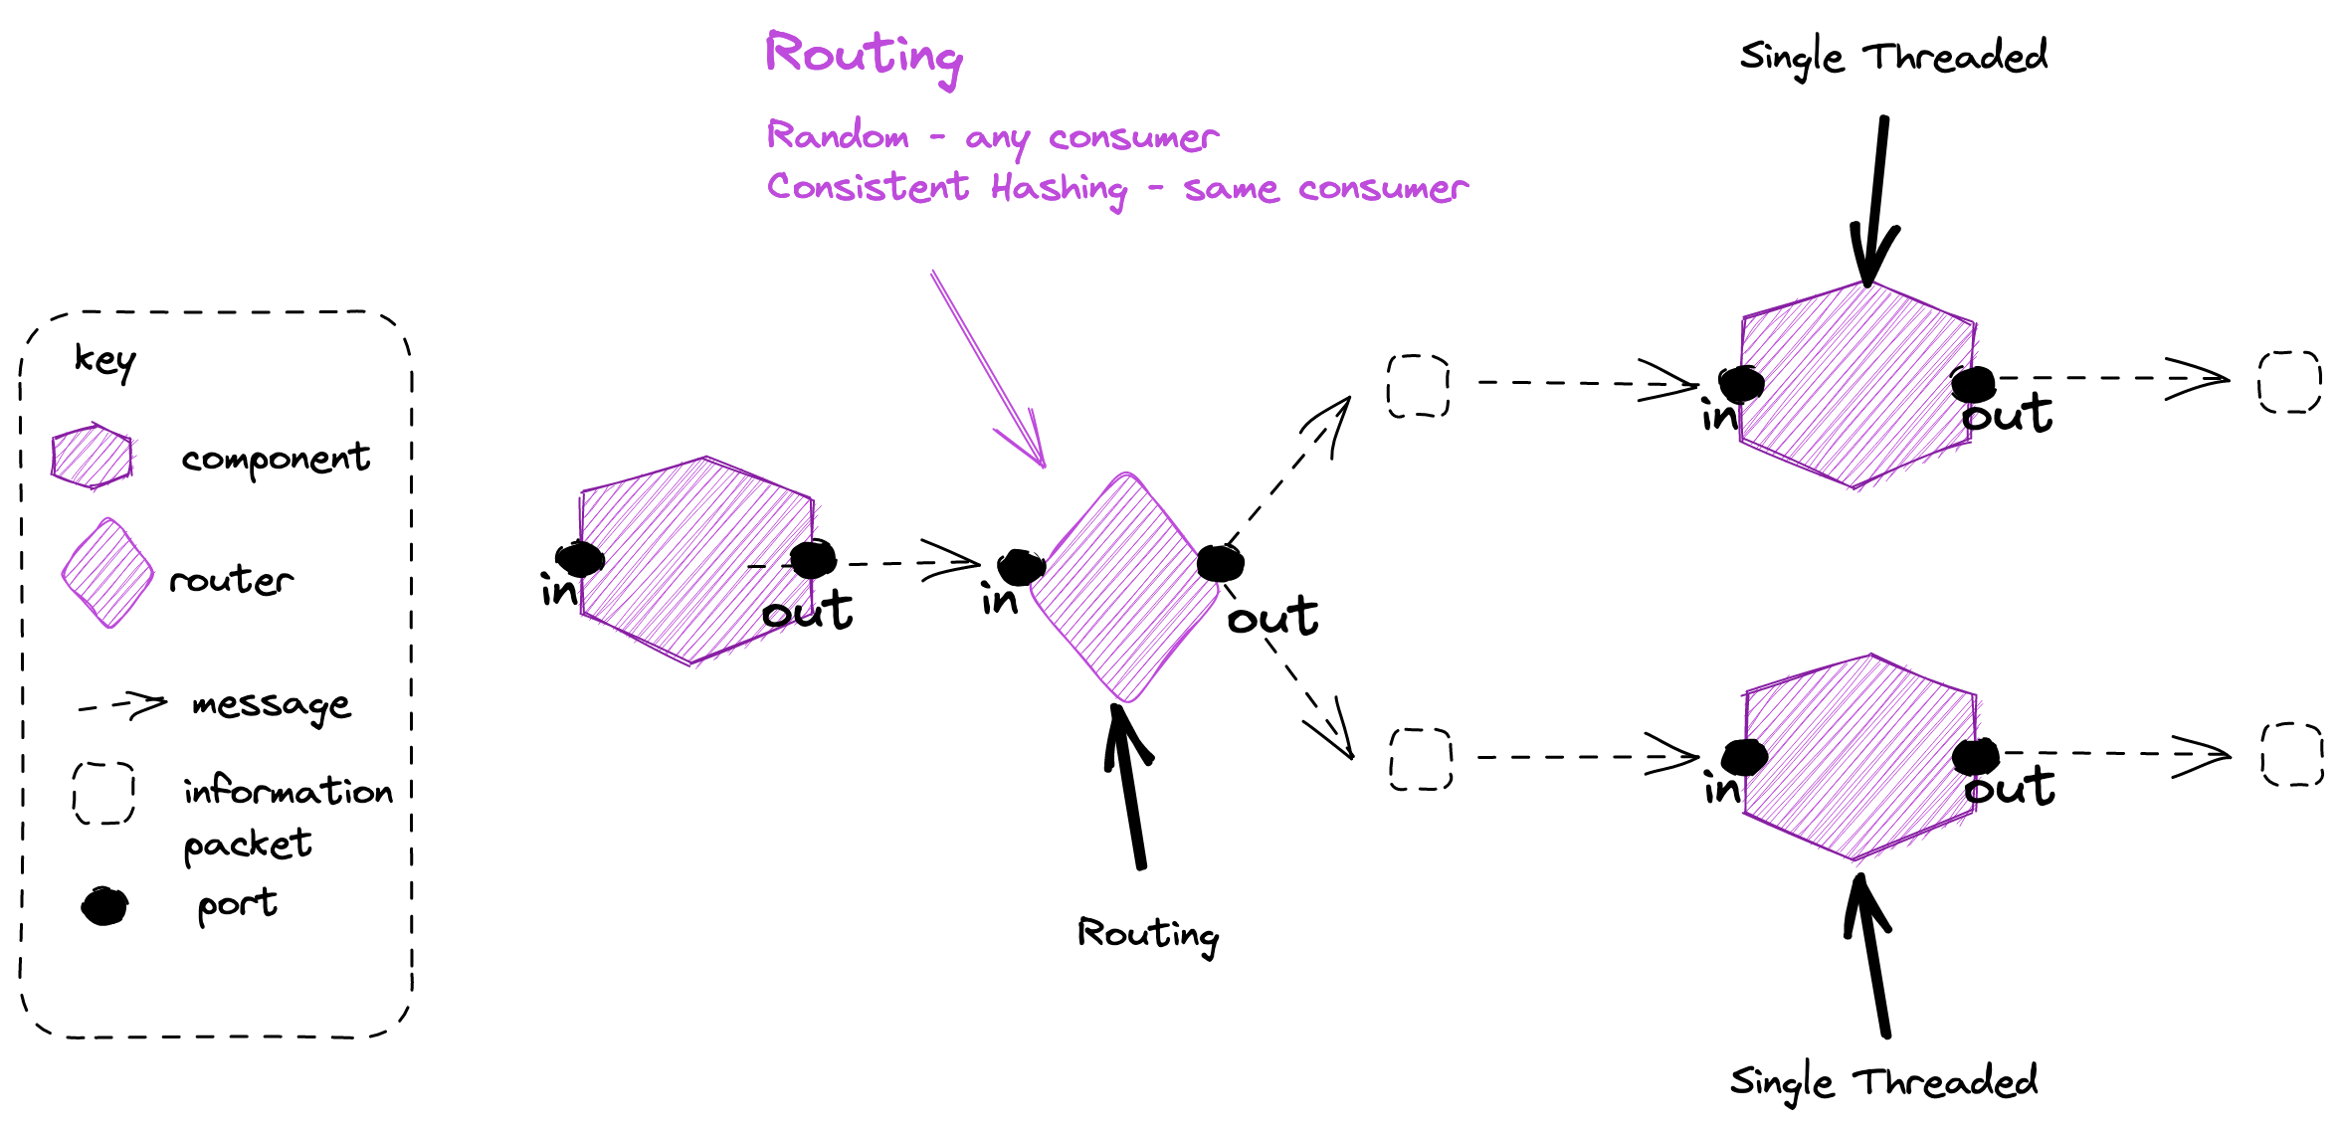
Single Threaded We can use the Reactor pattern for message processing and be single threaded, but if sequential updates are required we must be able to consistently hash messages to partitions when routing to scale
Notes:
Single Threaded nodes have lots of advantages:
Simpler programming model, I don’t have to worry about synchronization
No context switcthing

Slide 63
Agenda
T: 55
Objects
SOA
Reactive
Reactive Programming
Dataflow
Actors
Flow Based Programming
Reactive Systems
Message Passing
Resilience
Elasticity
Responsiveness

Slide 64
Value
Responsive
Form
Elastic
Resilient
Means
Message Driven

